Slide 1
Note for presenters:
This presentation is designed as an aid to help you share your career journey with students.
Please remember to keep the presentation conversational and get to know your audience!
Personalize your presentation by:
Updating slide 4 & 28 with your personal information and fun picture prior to the presentation.
Making your time with the students fun by sharing your journey in a way they can understand. Remember these students have little experience in accounting.
Reviewing the Notes section of the slides for presenter tips and opportunities to engage the students.

Slide 2


Let’s Talk Business

Slide 3




At the heart of every business is…
People
Products
Service
Marketing
Notes:
What do you think the heart of a business is? – Ask for a few responses from students.
Would you agree with what’s on the slide? Anything I’m missing here?

Slide 4
Name
Title
Company
I first became interested in accounting when…
My career started…
And now I…Which means I...
My favorite part of my job is…
The coolest thing I’ve done as a CPA is…
You might be surprised to learn I…
Notes:
It’s time to introduce yourself and share your story! The bullet points are available as prompts to share why you chose accounting and your journey thus far.
**Update this slide with picture(s) of yourself, name, title, company and bulleted information you would like to share.
Presenter Tip: Use this slide to include fun photos of your life (versus a headshot). This gives students a better glimpse into your life, and it will make your introduction more engaging and fun.

Slide 5

Accountants work in all types of organizations
Entrepreneur/
Start-Ups
Nonprofits
Companies of all Sizes
Governments
Sports & Entertainment
Accounting &
Consulting Firms
1047 Games
Weav
Symbrosia
Habitat for Humanity
Smithsonian
World Central Kitchen
Apple
Ikea
Bank of America
Zappos
Everlight Solar
City Government
FBI
NASA
Military
NFL
TikTok
Disney
Netflix
Local
Regional
National
International
Notes:
While I have worked <insert companies you have worked in>, accountants work in all types of organizations. Several of these names should look familiar to you.
Presenter Tip: Take a moment to highlight companies/industries specific to your state or area and explain how an accountant helps those companies. And add your own firm’s name above!
State Tip: Update the company names to highlight local start-ups, firms, etc.
Organizations listed above:
Start-Ups: 1047 Games, Weav (fintech startup), and Symbrosia (solving climate change) were all featured on Forbes 30 under 30
Nonprofits: Habitat for Humanity, Smithsonian and World Central Kitchen
Companies of all Sizes: Apple, Ikea, Bank of America, Zappos, Everlight Solar
Governments: Along with City Governments, there’s the FBI, NASA, and Military
Sports & Entertainment: NFL, TikTok, Disney (and the new Disney+) and Netflix
Accounting & Consulting Firms: Local, Regional, National and International

Slide 6

Accountants work with data and people.
They drive business decisions and strategy.
Typical responsibilities
Implement new accounting technologies and systems
Communicate information to business owners and investors
Analyze financial reports to evaluate business performance
Investigate potential fraud
Confirm financial laws and
regulations are followed
Advise clients on taxes
Help companies thrive in times of uncertainty
Ensure organizations are environmentally and socially responsible
Notes:
Now that we’ve reviewed the benefits of working in accounting, let’s talk about what accountants do.

Slide 7
What are you looking for in a future career?
Notes:
Now that I know the skills you have, let me ask you this. Have you thought about what are you looking for in a future career? <ask the students>
If they answer: What if I told you that you could do all of that with accounting?
If they don’t answer, ask: Who has the coolest job in your family?... Why?
Presenter Tip: A student might answer here that they are interested in becoming an artist, or something unrelated to business or accounting. No matter the career a student may say they want to pursue, point out how a background in accounting can help them. For example, as an artist you want to make sure that you’re bringing in more money than you’re spending on supplies in order to continue pursuing your passion. Learning about accounting and how businesses work will help you succeed in your career.

Slide 8









Money
Owning a Business
Traveling
Making an Impact
Teaching
Work / Life Balance
Professional Growth
Job Security
Notes:
Whether you’re interested in making money, owning a business, traveling, or making an impact in the world, Accounting can give you that and more! Let’s explore a few of these. Where would you like to start?
Presenter Tip: Click on an icon to advance to that slide and learn more. From there, click on the back arrow to take you to back to this slide, where you can choose another option. When you’re ready to advance the presentation, click the forward arrow above.

Slide 9

Accounting is money.
Accounting isn’t math. It’s money.
Accountants are the backbone of the business world and keep finances in check – for everyone.
Notes:
No matter the size of the company, accountants help organizations meet their goals by protecting financial resources.

Slide 10
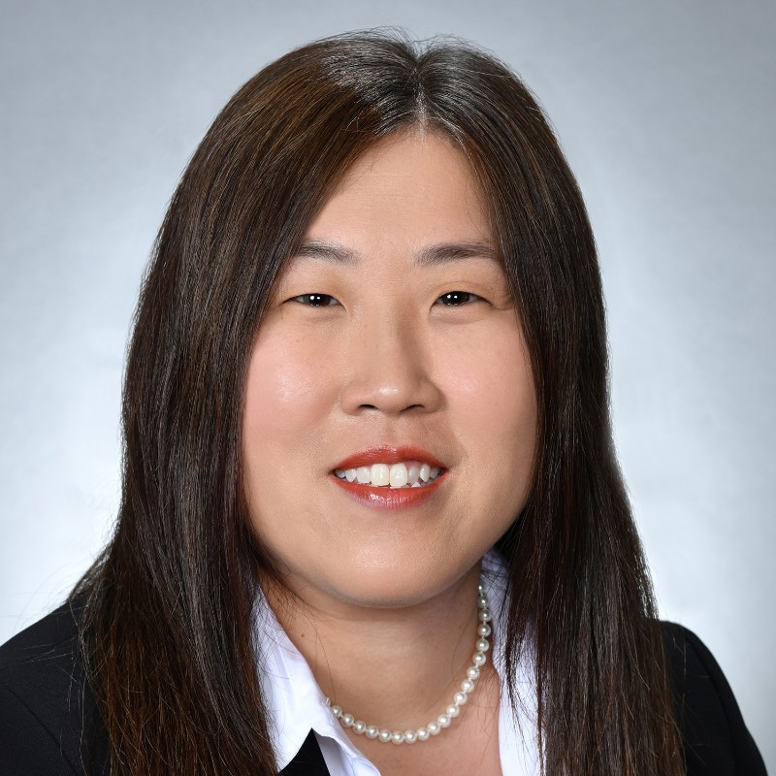
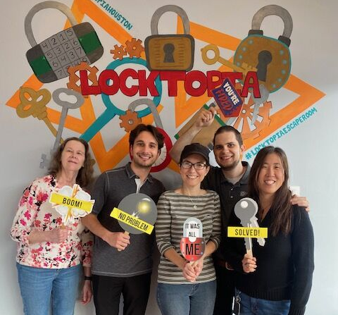

Charlotte Jungen, CPA, CFP ®
Chief Operating Officer/Chief Compliance Officer
Goodman Financial Corporation
Notes:
Let me introduce Charlotte to you.
Charlotte is a member of TXCPA and TXCPA Houston. She’s served on various committees and in state and chapter leadership roles.
She is currently the Chief Operating Office and Chief Compliance Officer for Goodman Financial Corporation.
When it comes to money, Goodman Financial is instrumental in providing financial and investment advice to individuals, trusts, business entities, and institutions such as endowments, nonprofits, pension plans and private foundations.
Charlotte has her CPA and her CFP, certified financial planner, credentials.
She attended Lamar University, where she was active in many organizations, include Beta Alpha Psi.
Charlotte began her career in Beaumont, working in public accounting as a senior accountant, and then as a Shareholder for a local firm.
When she moved to Houston, she began working for Goodman Financial as Client Service Manager, working her way up to COO.
Her organization is dedicated to giving back to the community, which gives Charlotte and her team additional opportunities to connect inside and outside the business.

Slide 11

Make an impact.
Accountants can also give back to their community by helping their favorite charity make every dollar count.
The new field in accounting is ESG: environmental, social and governance. Think carbon emission and climate change.
Notes:
Like Charlotte and Goodman Financials, many accountants give back to their communities.
Presenter Tip: If you are involved with a local charity, share your experience here!
A new field in accounting gives us another way to make an impact.
Those working in ESG, environmental, social, and governance reporting, ensure companies are complying with federal laws and regulations that hold them accountable to the world around them.

Slide 12
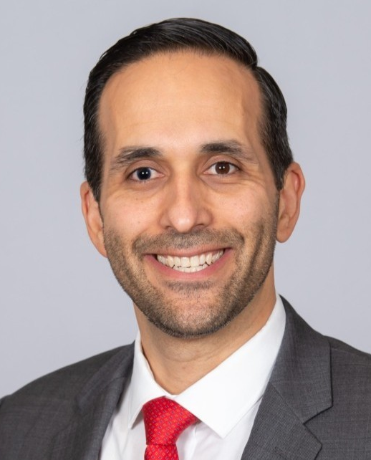
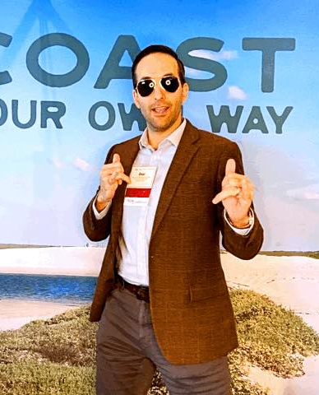
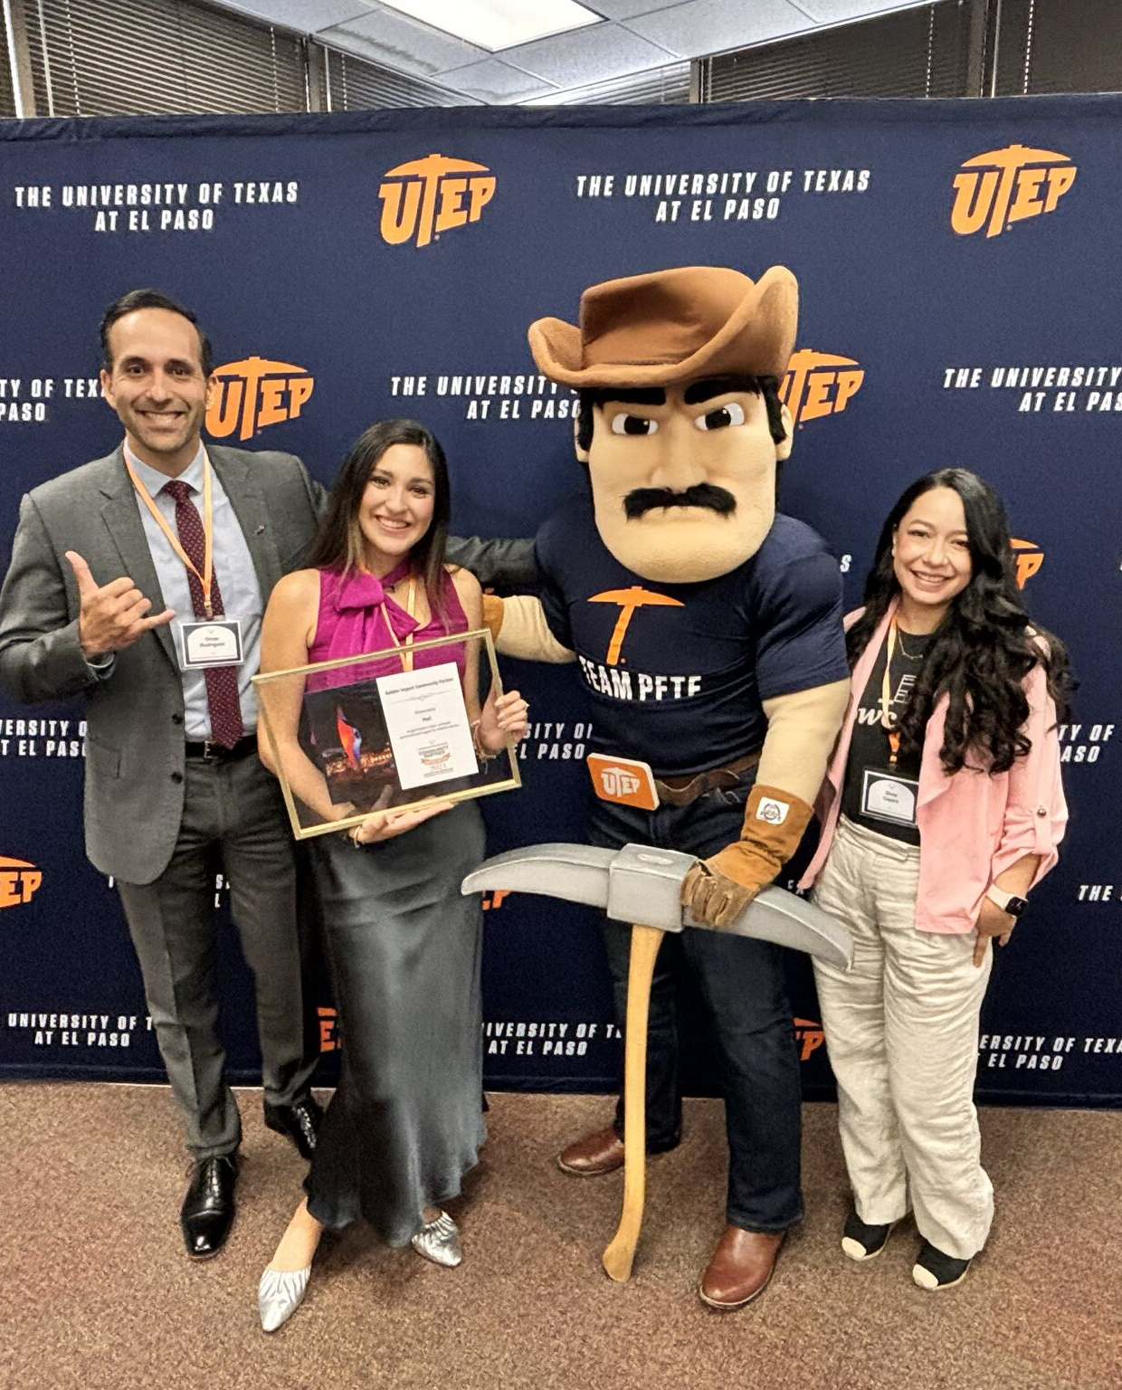

Omar Rodriguez, CPA
Director, Sustainability Reporting and Assurance
PwC
Notes:
This is my colleague and friend, Omar.
Omar is based in El Paso and serves as the Director of Sustainability Reporting and Assurance at PwC.
Not only is he working in one of the newest areas in our profession and society, but he also has the flexibility to work fully remote from El Paso and be close to his family and present for his young children and wife.
Omar loves to play hard and work hard.
He started his career in industry, working as a director for catholic church.
Omar then moved into auditing in a public accounting firm, moving to a large regional firm, and then Big 4 accounting firms.
He started working in the sustainability space in 2021 and often presents on the topic to help others in accounting learn more about this growing service area.

Slide 13

Share your knowledge.
Whether tutoring, teaching, or being a consultant for a large company, there are many individuals that can benefit from a conversation with an accountant.
Notes:
Like Omar teaches others in the accounting profession, some CPAs teach in the classroom, to help pave the way for others coming behind them.

Slide 14
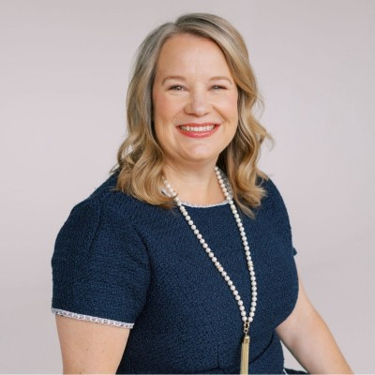
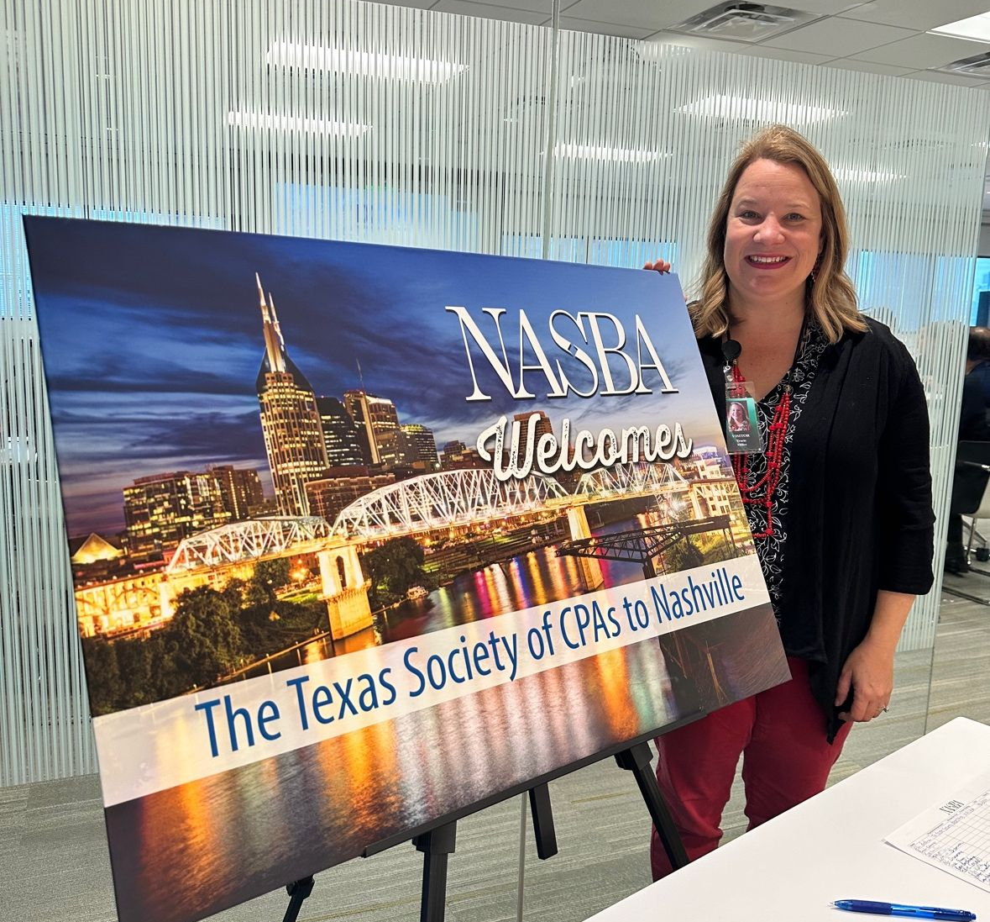
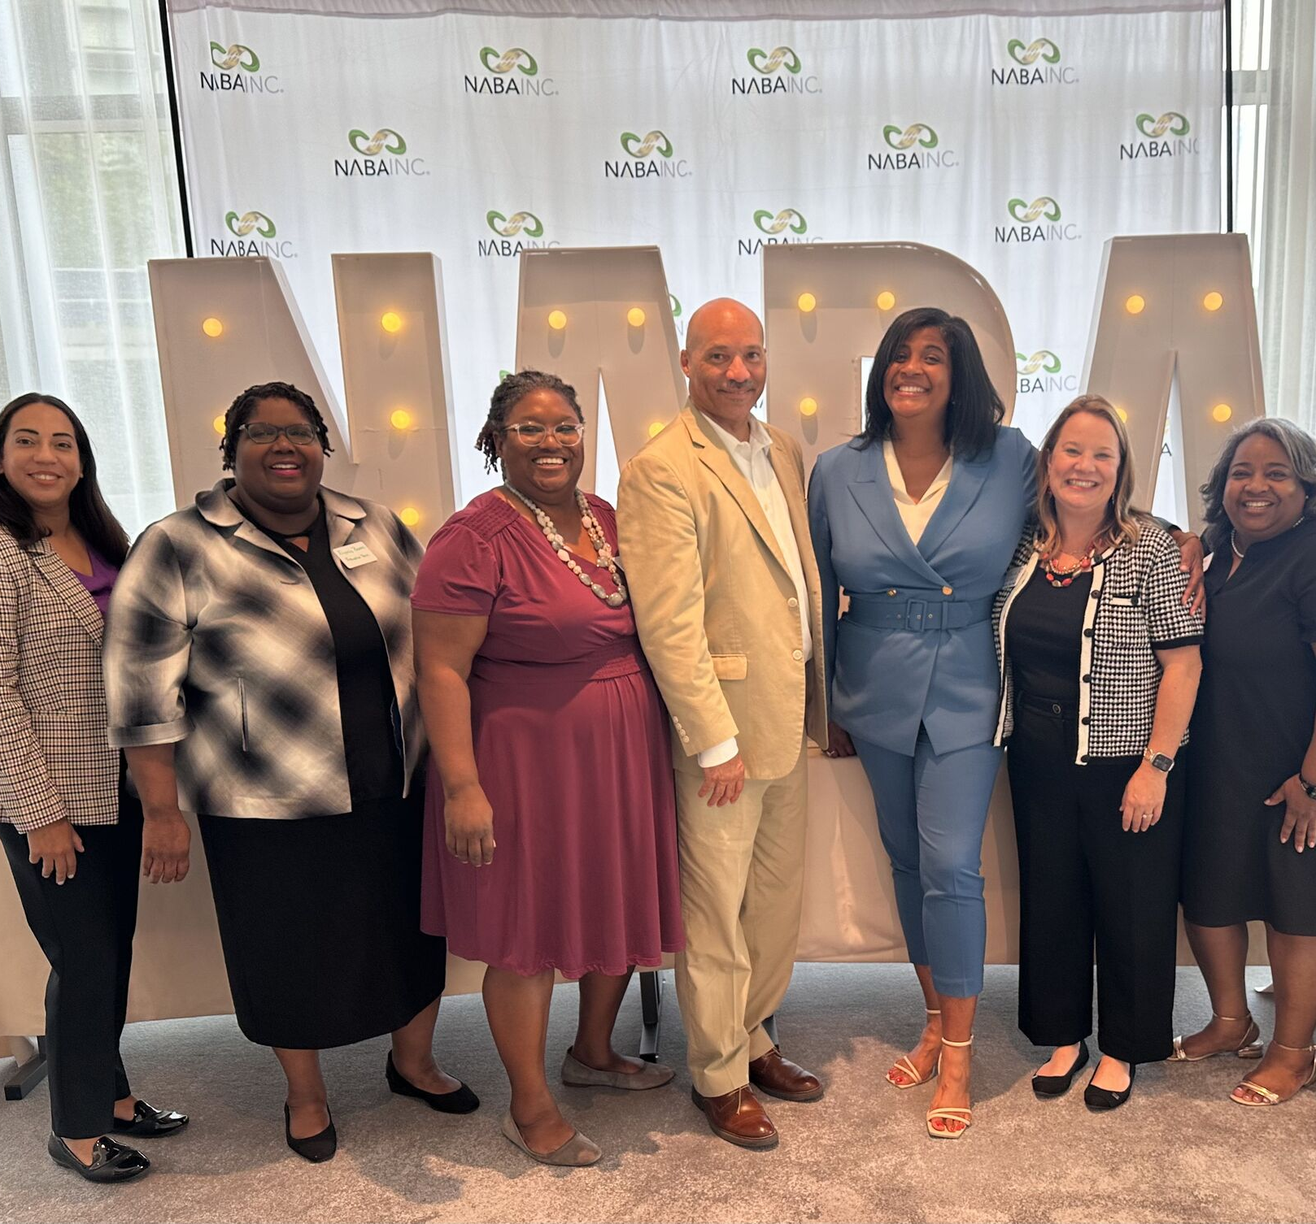
Tracie Miller, PhD, CPA
Program Chair
Franklin University
Notes:
Meet Tracie.
Tracie is the accounting program chair for Franklin University in Ohio. Like Omar, she does this in a fully remote capacity.
Tracie is based in Austin but also owns a home in Colorado where she spends part of the year. She teaches virtual courses to accounting students, has authored textbooks, and speaks frequently on issues impacting the number of students entering the profession.
Tracie has been an instructor and professor at two- and four-year colleges for many years, and she also spent part of her career working as a tax associate at one of the Big 4 accounting firms.

Slide 15

Travel the world.
CPAs meet their clients where they are.
That means opportunities for travel for you!
Notes:
Tracie has the opportunity to travel seasonally while working. Some CPAs travel the world for work and play.
Accounting careers provide work flexibility, with many companies offering the ability to work remotely, even worldwide!
Presenter Tip: If you have had the opportunity to travel for work, share your experience here!

Slide 16
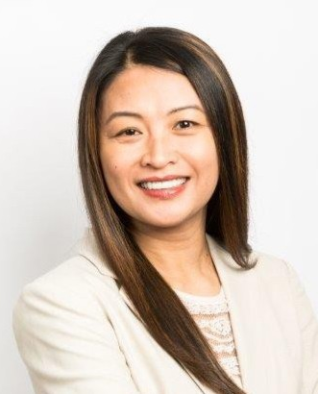

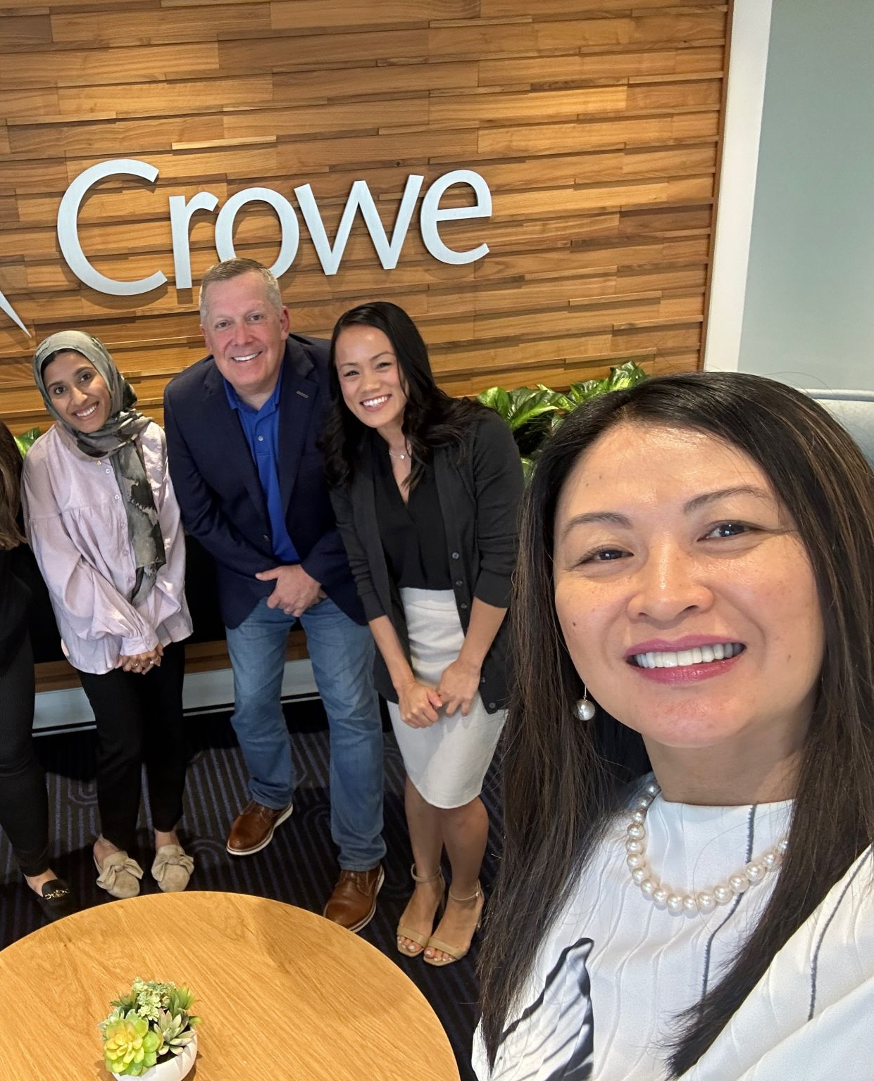

Sheila Enriquez, JD, CPA, CFF, CVA
Chief Growth Officer
Crowe
Notes:
This is my friend and a former TXCPA Chair Sheila.
Sheila is a very accomplished leader in our profession. She is currently the Chief Growth Officer for Crowe.
Sheila also loves to work and play hard. You can find her traveling coast to coast and overseas – for work and for fun.
She has two sons, one majoring in accounting at UT and one in high school, and she speaks often of the importance of work/life integration.
Sheila came to the US as an international student and navigating an incredibly successful path in accounting.
She started in public accounting in auditing and has held roles from senior manager to managing partner and CEO. She also served as Crowe’s Chief Diversity, Equity, and Inclusion Officer.
You see she has several credentials in addition to the CPA. Sheila is an attorney, certified in financial forensics, and a certified valuation analyst.
One of the exciting parts of Sheila’s role is serving as an expert witness in court.

Slide 17

Grow professionally.
Your career growth is in your hands.
As a CPA, you can go into any industry and change your path at any time.
Notes:
Sheila is an excellent example of professional growth – taking her career to incredible places.
Your career growth is in your hands. As a CPA you can go into any industry and change your path at any time. As the world changes and businesses evolve, there are many opportunities for training and growth.

Slide 18
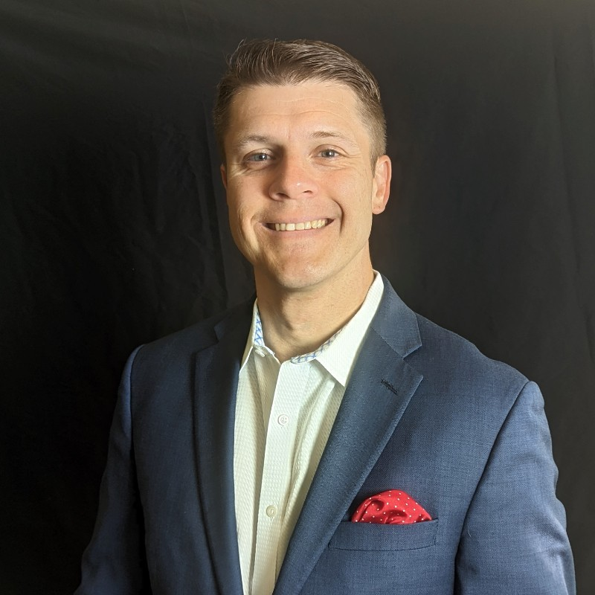

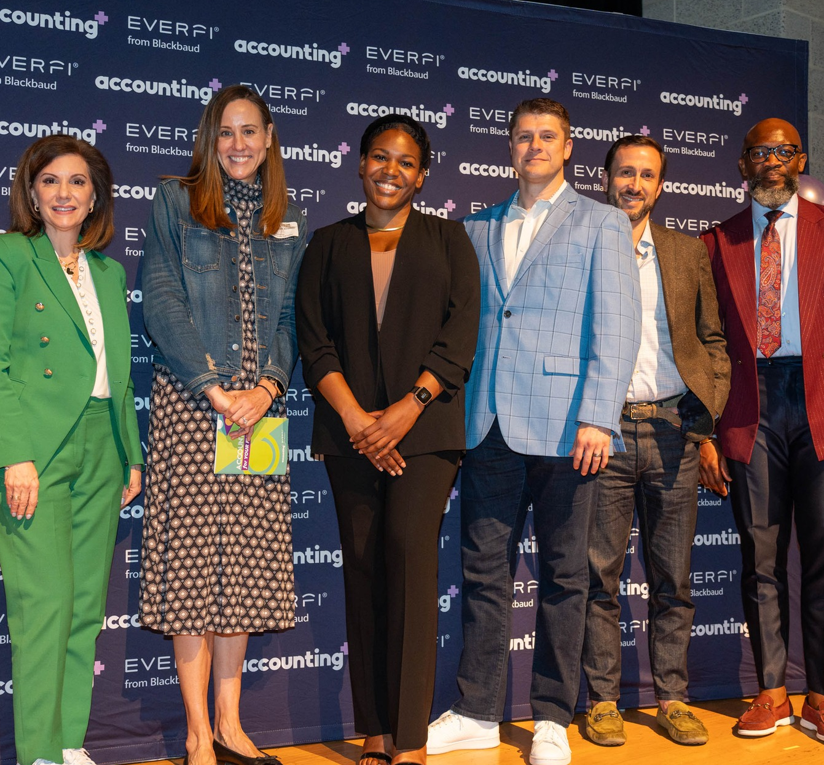
Kenny Broom, CPA, CBP
Director
Securitize
Notes:
That brings us to the last colleague’s story that I’ll share today. This is Kenny.
Kenny is a CPA and Certified Bitcoin Professional. Like, Omar, Kenny has become a leader in a new space for our profession.
He is currently a Director for Securitize, but his career has taken many turns.
He graduated with a business management degree, worked in sales, coached college soccer, did financial advising, attended seminary, sold insurance, and then obtained his masters in accounting and his CPA.
You can tell Kenny has many interests and activities, and he found his CPA to be a key piece of the puzzle to securing a future full of even more possibilities.

Slide 19

Feel secure.
As an accounting graduate, you will always be in demand and are afforded a clear career path with advancement opportunities.
Notes:
All of these stories illustrate the variety of paths and possibilities in accounting.
And they all show how secure your career can be as an accounting graduate.

Slide 20


Accountants have many
Chief Financial Officer (CFO)
Tax
Advisor
Forensic Accountant
opportunities
Owner/
CEO
Audit Manager
Financial Planner
Data Analyst
Notes:
We’ve just met some CPAs with pretty cool jobs. These are just some of the other job titles you could have as an accountant.
Presenter Tip: Share some of the various job titles you have held throughout your career, highlighting the progression or path changes you have made.

Slide 21

What kind of accountant are you?

Slide 22

Accountant or CPA – what's the difference?
CPAs are Accountants who:
Are certified – CPA stands for Certified Public Accountant
Earn more throughout their career
Garner more trust and respect
Experience greater job security
Can become even more specialized
Take on highly valued, consulting roles
Notes:
While all CPAs are accountants, not all accountants are CPAs. CPAs are accountants who are certified. CPA stands for Certified Public Accountant. A CPA is a trusted advisor to individuals, businesses, and other organizations, helping each achieve their financial dreams and goals. Whether advising businesses on multi-million-dollar acquisitions, auditing companies’ 401K plans, or helping people invest for retirement, a CPA’s adherence to a strict code of ethics along with accounting and finance expertise allows the public to put their trust in CPAs.
To become a CPA, they had to meet their state’s experience and education requirements, pass 4 sections of the CPA Exam and, in some states, complete an ethics requirement as well.

Slide 23


What do you need to become a CPA?
+
+
+
=
Education
Experience
Ethics*
Exam
CPA
* Certain states require a separate ethics assessment in addition to what is tested on the CPA Exam.
Notes:
What does it take to be a CPA? Exact requirements vary by state, but essentially all CPAs need…
The 4 E’s:
Experience (1-2 years in most states)
Education (150 hours – in Texas you can begin sitting for the CPA Exam at 120 hours while you finish your credits for licensure – and starting in August 2026 a pathway will be available for a bachelor’s + two years of relevant work experience)
Examination (passing 3 core sections and your choice of a discipline)
Ethics (Texas requires this, but some states do not require this)

Slide 24




Could the CPA license be right for you?
RAISE YOUR HAND IF YOU…
Want flexibility in your career
Like puzzles
Like technology
Like working in teams
Like helping people
Like detective work
Want to learn the language of business
Notes:
So, could the CPA license be right for you?
Presenter Tip: Make this part interactive and ask the students to raise their hand for each question they relate to.
If this sounds like you, explore becoming licensed!

Slide 25

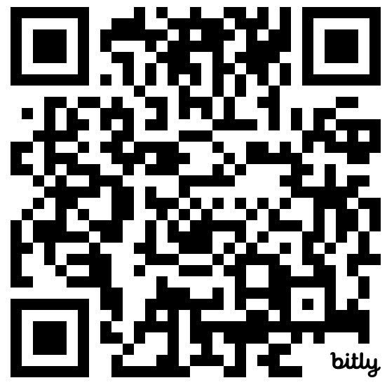
Join!
TXCPA offers FREE student membership!
Connections with 28,000 members across Texas
Scholarship opportunities
The latest updates on the profession
Mock CPA Exam events
And more!
Notes:
College students are eligible for free TXCPA student membership.
We invite you to join and get engaged in TXCPA and the local chapter where you can learn more and meet other CPAs in our community.

Slide 26


Notes:
And we have two brand-new engagement opportunities for student and candidate members.
Our Candidate Community is a members-only online forum where future CPAs can connect with each other and receive encouragement and advice from our community of members. You can review recent posts and add questions of your own.
Coming soon is our Mentor Match program where student and candidate members will have the opportunity to connect with a CPA mentor to ask questions, get advice, and build their networks.
Be sure you join TXCPA so you can get the latest updates as we continue to add value and benefits for our future CPAs!

Slide 27

Questions?
Notes:
At this point, students can ask questions.

Slide 28


Thank You
Presenter name
Email address
Website address
Notes:
Update this slide with your contact information as you close out the session. If you’re willing, suggest that students take down your information if they have any future questions.

