Slide 1
ACCOUNTING: A CAREER
YOU CAN COUNT ON
(SPEAKER NAME)
(HIGH SCHOOL NAME/LOCATION)
(DATE)
Notes:
Good morning/afternoon everyone,
Today’s a good day because I get to tell you more about the profession I know and love, the endless opportunities that await you in accounting and as a CPA, as well as what it takes to get there.
Who knows what CPA stands for? Wait for an answer Certified Public Accountant.
I am a CPA and look forward to telling you a little more about my career journey. My name is [insert name] and I am a [position/title] at [firm/organization]. Believe it or not I once was sitting where you are now trying to figure out what I wanted to do with my life! My hope is that telling you a bit more about how I got to where I am and some specifics about the career will help you consider accounting and a future as a CPA – while dispelling any of your preconceived notions about the profession.
Possibilities for telling your journey:
Why you decided to become a CPA.
Where did you go to school?
How/when did you take the exam? Did you pass/fail?
Words of wisdom you received or learned that could help them through the journey.

Slide 2
WHO IS TXCPA?

Slide 3
WHY ACCOUNTING? WHAT DO THEY DO?

Slide 4
WHY YOU SHOULD CONSIDER ACCOUNTING

Slide 5
ACCOUNTANT VS. CPA: WHAT’S THE DIFFERENCE?

Slide 6
HIGHER EARNINGS

Slide 7
THE WORLD NEEDS SKILLED ACCOUNTANTS

Slide 8
WHERE YOU CAN WORK AS A CPA

Slide 9
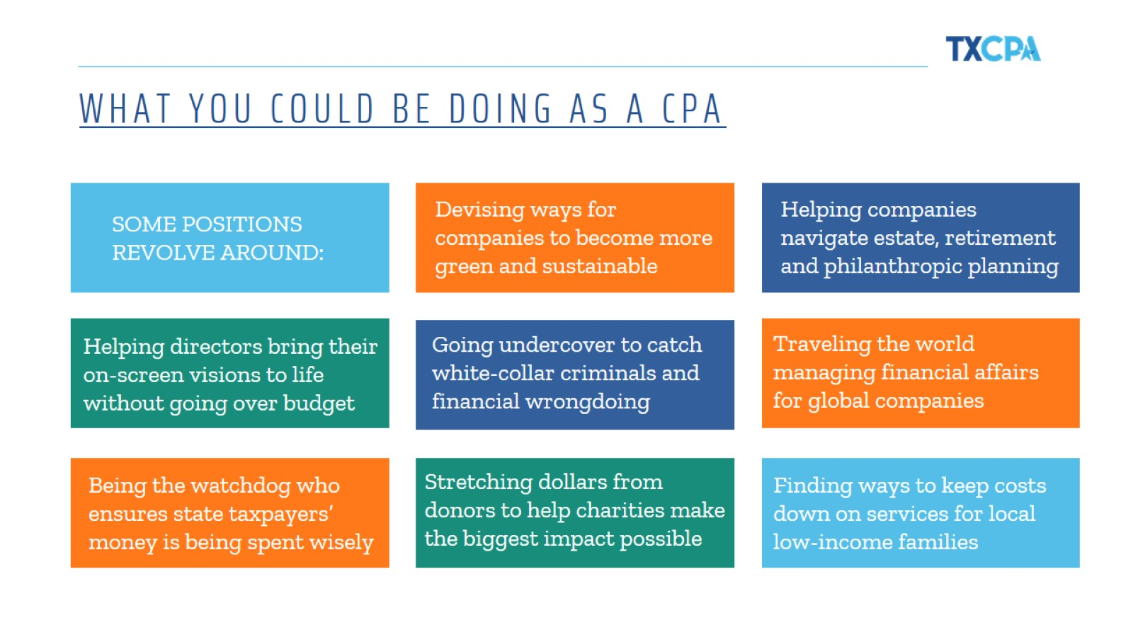
WHAT YOU COULD BE DOING AS A CPA

Slide 10
AS A CPA: SECURITY IS INCLUDED

Slide 11
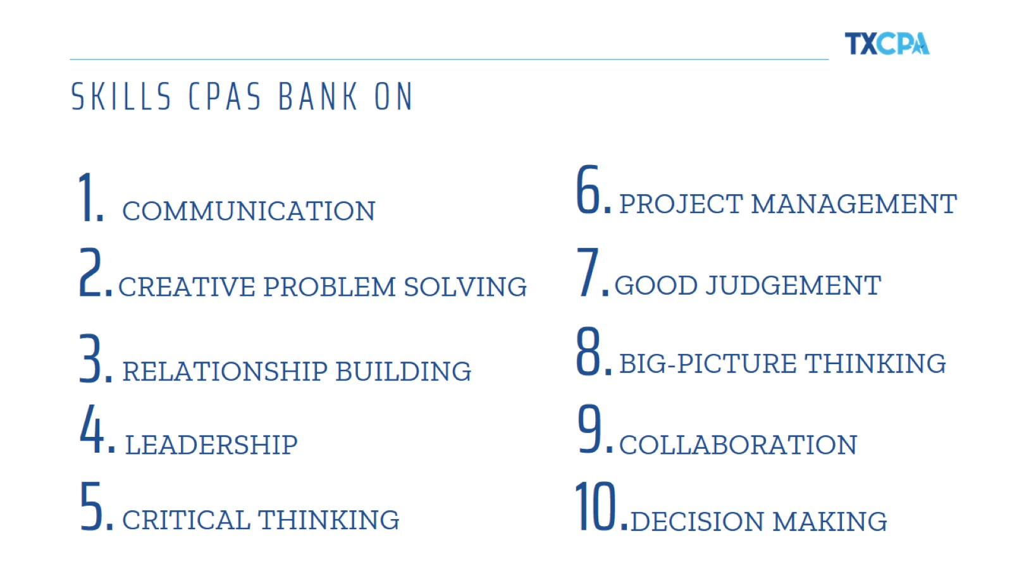
SKILLS CPAS BANK ON

Slide 12
STEPS TO CPA GREATNESS

Slide 13
FUTURE CPA CAREER FINDER

Slide 16
WE’RE SOCIAL!

Slide 17
(Name)
(Job Postition)
(email)
(Chapter Name)
(Chapter Phone)
(Chapter website)
Notes:
If a question pops in your head that didn’t get asked today, please don’t hesitate to reach out to [insert your contact information, or TX.cpa, or chapter representative].

