Slide 1


ACCOUNTING CAN TAKE
YOU ANYWHERE…
WHERE DO YOU WANT TO GO?
(SPEAKER NAME) | (COMPANY) | (TITLE)
(HIGH SCHOOL NAME/LOCATION)
(DATE)
Notes:
Good morning/afternoon everyone,
Today’s a good day because I get to tell you more about the profession I know and love, the endless opportunities that await you in accounting and as a CPA, as well as what it takes to get there.
Who knows what CPA stands for? Wait for an answer Certified Public Accountant.
I am a CPA and look forward to telling you a little more about my career journey. My name is [insert name] and I am a [position/title] at [firm/organization]. Believe it or not I once was sitting where you are now trying to figure out what I wanted to do with my life! My hope is that telling you a bit more about how I got to where I am and some specifics about the career will help you consider accounting and a future as a CPA – while dispelling any of your preconceived notions about the profession.
Possibilities for telling your journey:
Why you decided to become a CPA.
Where did you go to school?
How/when did you take the exam? Did you pass/fail?
Words of wisdom you received or learned that could help them through the journey.

Slide 2
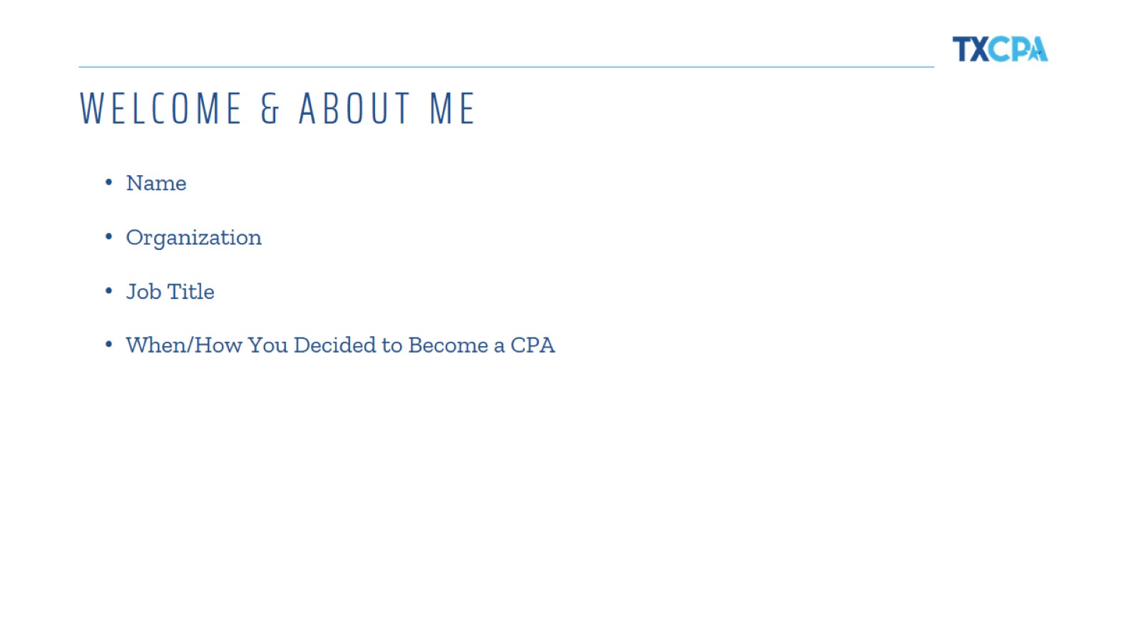
WELCOME & ABOUT ME
Notes:
Talk about yourself and your background here. Feel free to add more slides, photos, information, etc. This is where you tell your personal career story and what led you to become a CPA!

Slide 3
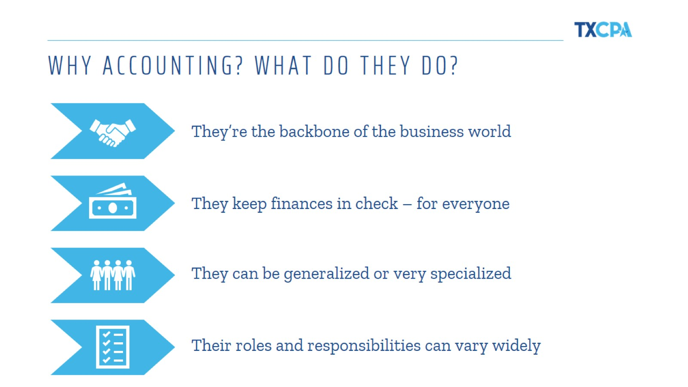
WHY ACCOUNTING? WHAT DO THEY DO?
Notes:
So, why are accountants and CPAs a big deal? Well they are the backbone of the business world, and often lead the business world! They make sure all finances are in check for individuals and businesses. They are respected, trusted and admired by many for the impact they have in their community and the business they work for.

Slide 4
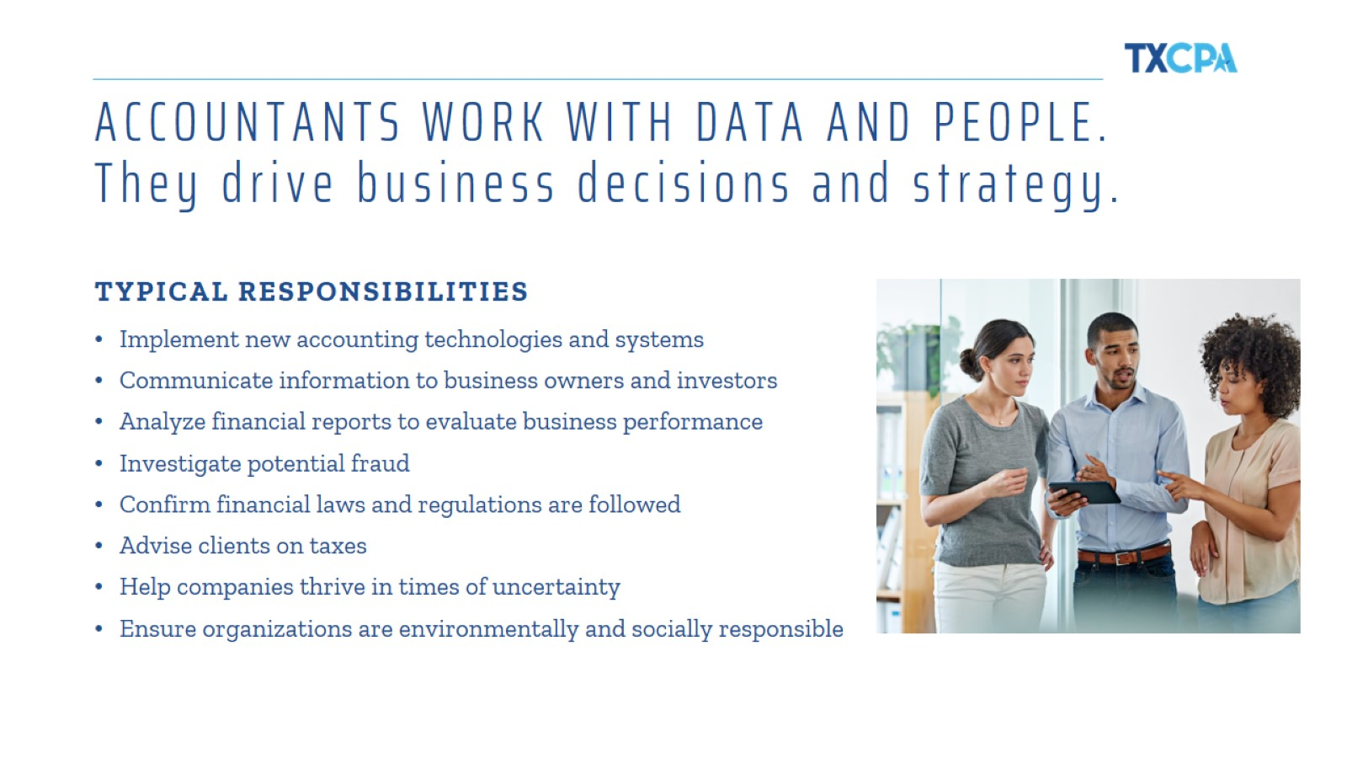
ACCOUNTANTS WORK WITH DATA AND PEOPLE.
They drive business decisions and strategy.
Notes:
Presenter Tip: Share more about your role and some of your typical responsibilities, while relaying it in a way that high school students will understand.

Slide 5
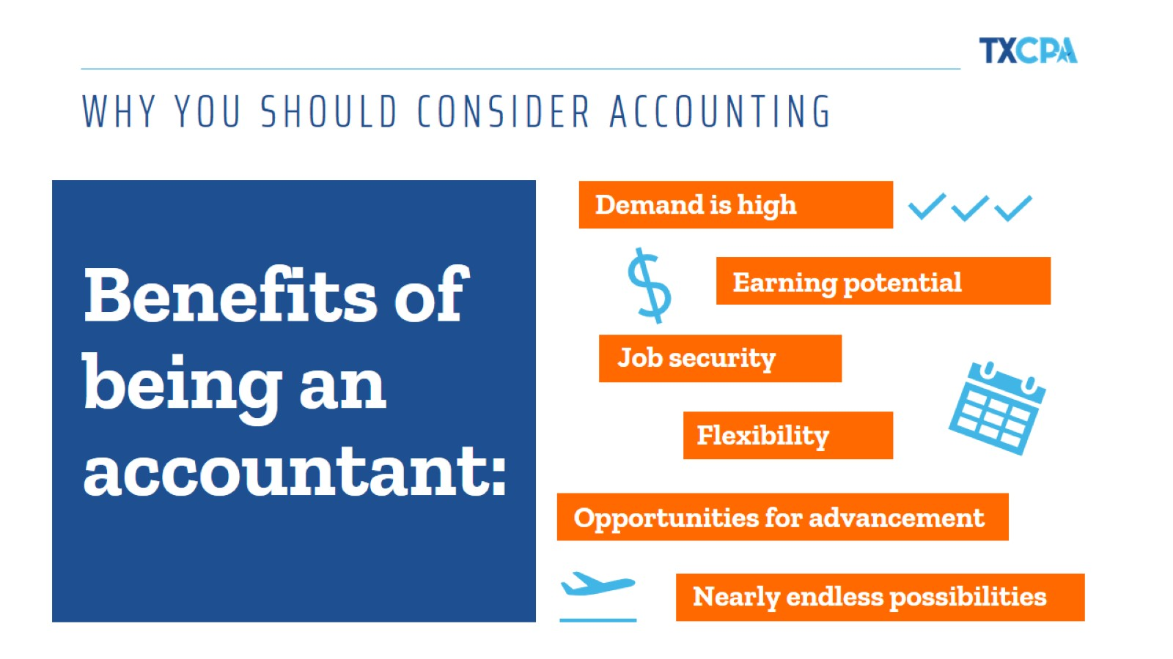
WHY YOU SHOULD CONSIDER ACCOUNTING
Notes:
There are so many reasons why you should consider this profession, but I would be here all day and I doubt you would want that! So I will delve into just a few a bit more!
Demand: There are more positions than skilled accountants to fill them. As organizations are becoming more and more globalized, the need for skilled accountants—especially those with diverse backgrounds and experiences—is only going to continue to grow.
Earning potential: Those who work with money bring home a good amount, too. According to the 2017 Robert Half Salary Guide, Junior-level accountants in large firms make between $69,250-$90,000 per year. Those with more experience make far more than that—we’re talking six, or even seven, figures!
Job security: It’s one of the most recession-proof careers out there. While changes in the economy tend to have a direct impact on many professions, money matters are often even more critical when the market isn’t as hot. This affords many accountants much greater job stability regardless of what’s going on in the world.
Flexibility: Work/life balance is a priority for big accounting firms. According to an article by the New York Times, big accounting firms have done the math and seen that creating better work/life balance for employees is financially beneficial. Plus, much of the work accountants do can be done from anywhere, which makes managing life and deadlines much easier and helps prevent burnout.
Opportunities: Prove yourself and the sky’s the limit. Accountants hold everything from entry-level jobs to CFO positions and everything in between. Depending on what route you decide to take, promotions can come on a fairly regular basis and offer even more opportunity to focus on the aspects of your job that interest you the most.
Possibilities: Accountants do many different things in every industry. Accountants work in every industry under the sun. So whatever you’re into—whether it’s food, photography or football—there’s a professional who accounts for it. That means if you decide as an accountant that you want to mix things up, there’s always another industry or position that’s ready to welcome you with open arms.

Slide 6

Accountant or CPA – what's the difference?
Notes:
I decided to become a CPA [insert your reason]!
While all CPAs are accountants, not all accountants are CPAs. CPAs are accountants who are certified. CPA stands for Certified Public Accountant. A CPA is a trusted advisor to individuals, businesses, and other organizations, helping each achieve their financial dreams and goals. Whether advising businesses on multi-million-dollar acquisitions, auditing companies’ 401K plans, or helping people invest for retirement, a CPA’s adherence to a strict code of ethics along with accounting and finance expertise allows the public to put their trust in CPAs.
To become a CPA, they had to meet their state’s experience and education requirements, pass 4 sections of the CPA Exam and, in Texas and some other states, complete an ethics requirement as well.

Slide 7
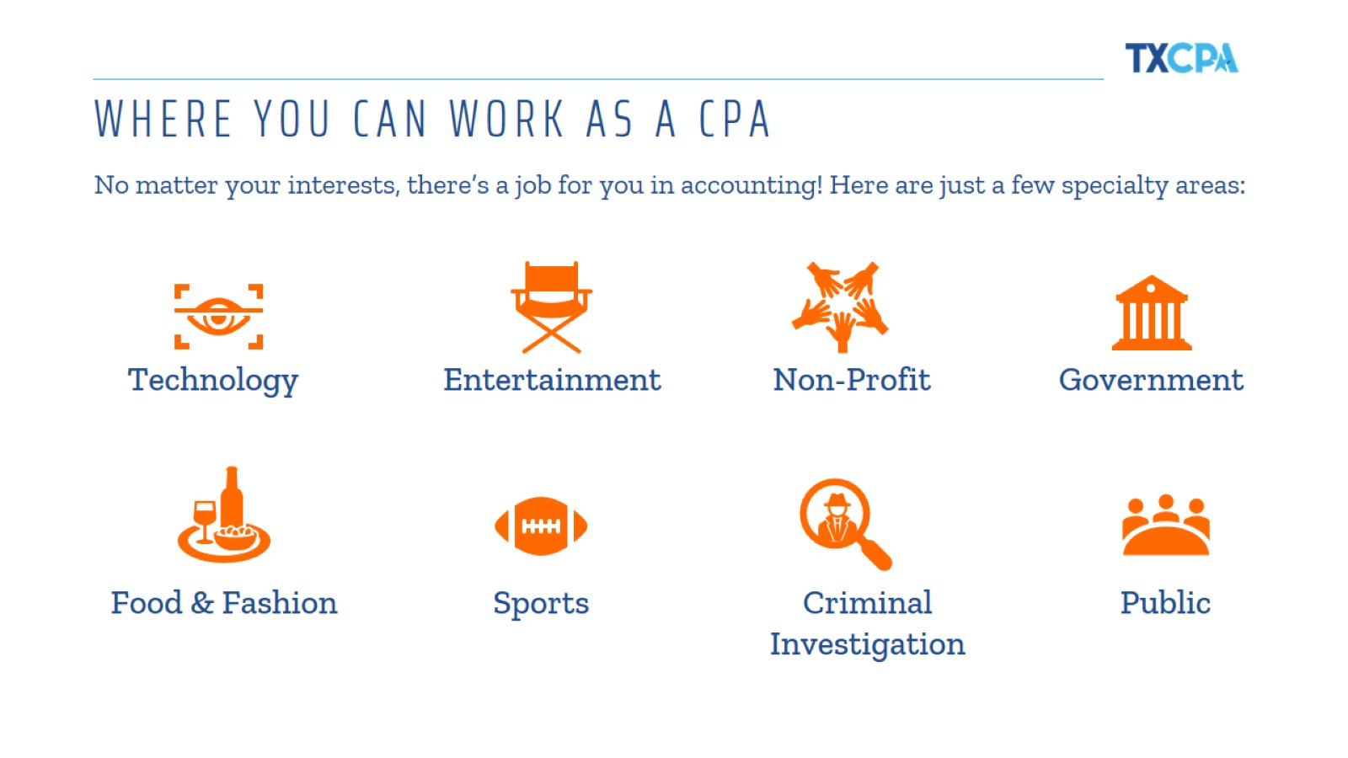
WHERE YOU CAN WORK AS A CPA
Notes:
CPAS: KEEPING EVERY INDUSTRY ON TRACK – These are just Some of them!
Accountants are behind pretty much every sound financial decision and have become some of the most important decision makers in business. Because they understand their companies inside and out, they often hold the all the answers!
There are also tons of cool jobs for CPAs you may not even know about. Like financial forensics. Join the FBI or other law enforcement agencies and you could help investigate and stop white-collar financial crimes.
Are you a pop culture junkie, movie addict or die-hard music fan? Turn your love of entertainment into a career as a CPA for big name stars, movie studios, musicians and authors.
You dream it, you can be it or be the CPA for it! There is truly endless possibilities with this career.

Slide 8
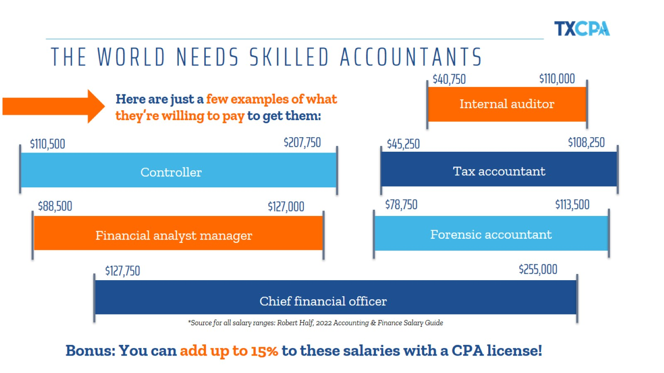
THE WORLD NEEDS SKILLED ACCOUNTANTS
Notes:
These are just a few examples of salary ranges for various accounting positions.
As you can see, the growth and earning potential are impressive – and remember, you can add 5% - 15% to your salary with a CPA license.

Slide 9
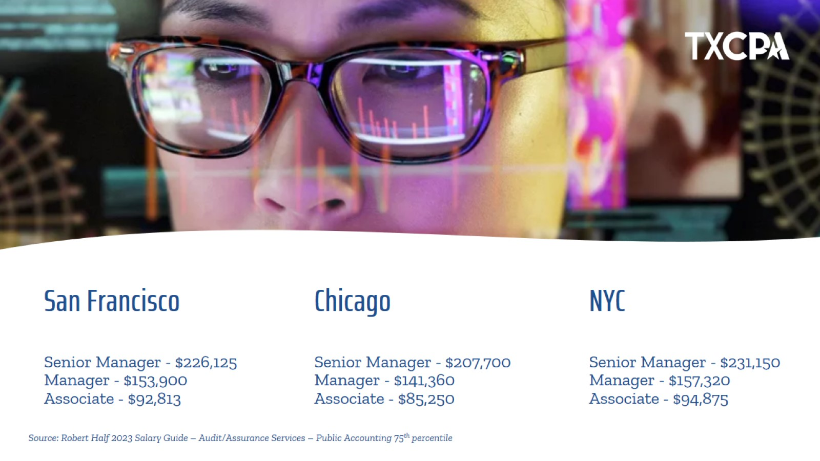
San Francisco
Senior Manager - $226,125
Manager - $153,900
Associate - $92,813
Notes:
And accountants make good money. The salaries referenced here are from the Robert Half Salary Guide – Audit/Assurance Services in Public Accounting, and represent the 75th percentile. National Averages can be found below. Stay the course and make Partner, and start around $400K+ per year.
National Average
Senior Manager - $167,500
Manager - $114,000
Associate - $68,750

Slide 10

WHAT ARE YOU LOOKING FOR IN A CAREER?
Notes:
Whether you’re interested in making money, owning a business, traveling, or making an impact in the world, Accounting can give you that and more! Let’s explore a few of these. Where would you like to start?
Presenter Tip: The following slides discuss each of these categories in more detail.

Slide 11
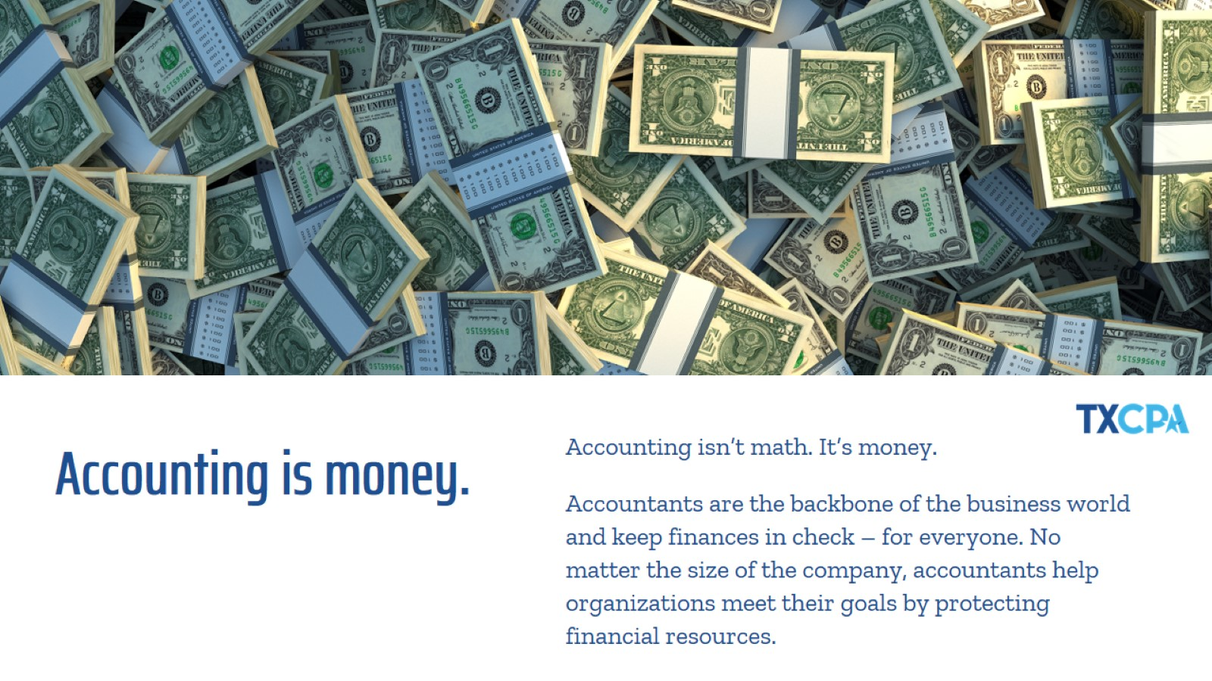
Accounting is money.

Slide 12

Follow your passion.
Notes:
If you’re interested in owning your own business and being your own boss, consider majoring in accounting. You’ll have the financial know-how to ensure your company is a success!
“Spending a few years working in an accounting role for a firm or industry can be wonderful training for future entrepreneurs. They get to see first-hand how businesses operate and are financed and learn other important lessons that will help them succeed as they launch their own companies.” – Jerry Maginnis, CPA Advice for a Successful Career in the Accounting Profession

Slide 13

Travel the world.
Notes:
In addition to travel, accounting careers provide work flexibility, with many companies offering the ability to work remotely, even worldwide!
Presenter Tip: If you have had the opportunity to travel for work, share your experience here!

Slide 14

Make an impact.

Slide 15

Share your knowledge.
Notes:
CPAs also work in the classroom, to help pave the way for others coming behind them

Slide 16

Make it balance.
Notes:
Presenter Tip: Share a positive personal story of the lifestyle/flexibility being a CPA has afforded you. If students mention busy season, say yes, there are times when accountants are busy, but there are also times when they have a lighter workload. The schedule varies depending on the type of accountant you choose to be.

Slide 17

Grow professionally.
Notes:
Your career growth is in your hands. As a CPA you can go into any industry and change your path at any time. As the world changes and businesses evolve, there are many opportunities for training and growth.

Slide 18

Feel secure.
Notes:
“Accounting is solid. You can always get a job as a CPA.” -Colleen Conrad, NASBA

Slide 19
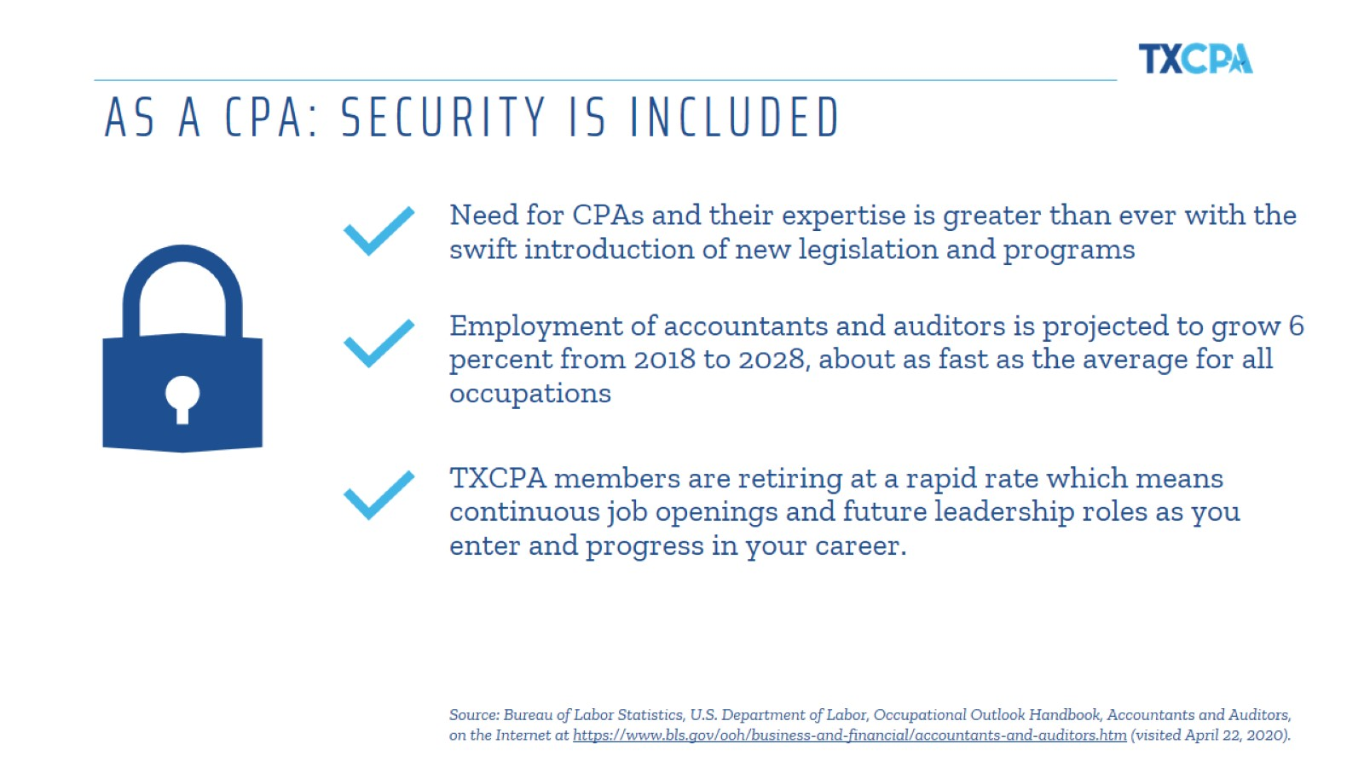
AS A CPA: SECURITY IS INCLUDED
Notes:
Given the current landscape, it is likely no surprise that the unemployment rates are at an all-time high. But the awesome news is that CPAs are indispensable and, therefore, the need for them is greater than ever.
With the changes to the business environment, the introduction of new legislation and programs, and the expansion of existing ones, the changes have been swift.
We see clients having to make complex and confusing choices that may have long-term (and short-term) consequences.
To add clarity to the chaos, many are turning to their CPAs as they grapple with these challenging times and attempt to navigate available incentives.
As you can see, the need for CPAs is even greater in order to help organizations and individuals navigate all the changes and serve as their trusted advisor now and into the future.

Slide 20
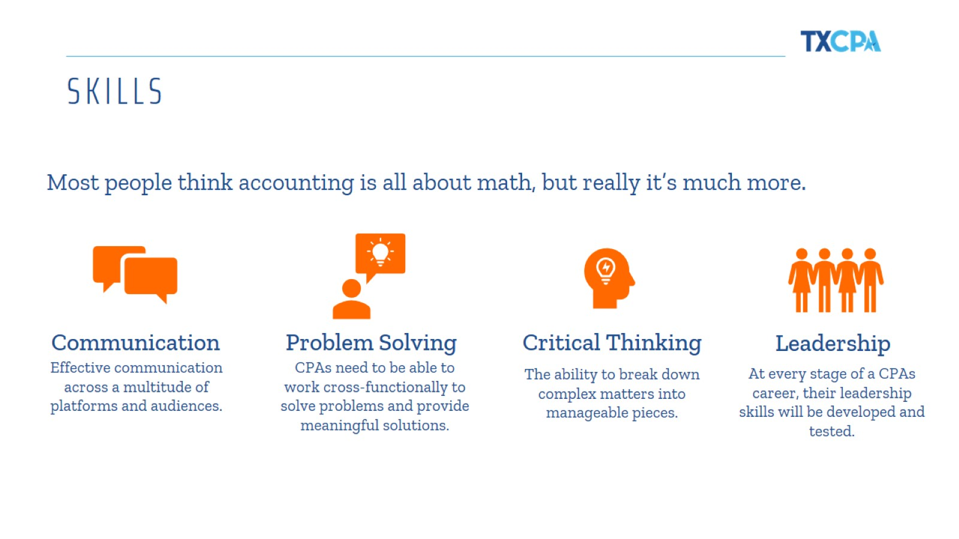
SKILLS
Notes:
Since the CPA profession is constantly evolving, just like you, we never stop learning. In fact, CPAs are required to meet education requirements as part of our license renewal process.
When you look at this list of skills, you might not immediately think they are accounting or business related or that they are skills beneficial in the field. But communication, problem solving, critical thinking and leadership are all important and necessary as a CPA.
I’d encourage you to broaden your scope and take advantage of any opportunities you find to add these to your list of talents now and in the future.
[Provide an example when you’ve used one (or more!) of these skills in your job]

Slide 21

Could accounting be right for you?
Notes:
So, could accounting be right for you?
Presenter Tip: Make this part interactive and ask the students to raise their hand for each question they relate to.
If this sounds like you, explore accounting!

Slide 22
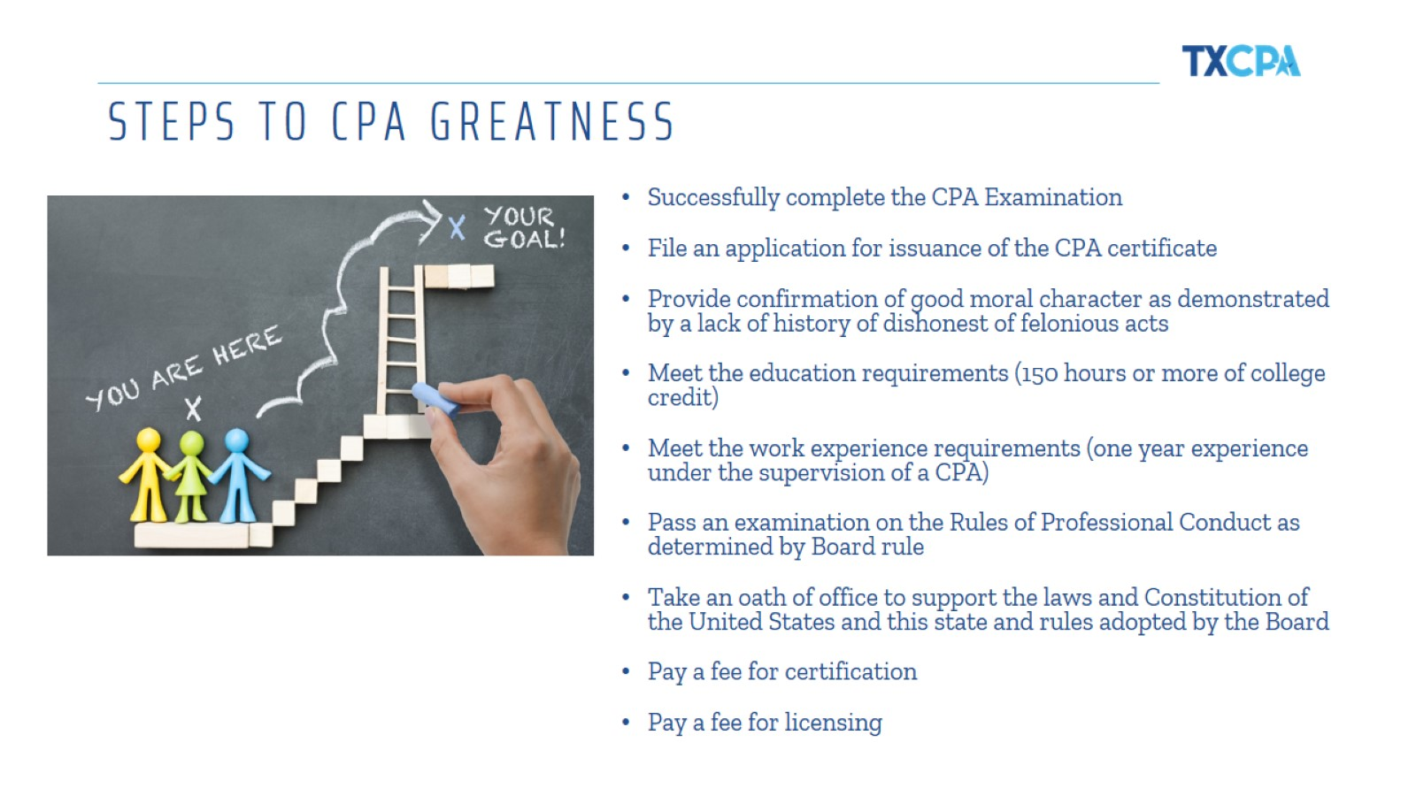
STEPS TO CPA GREATNESS
Notes:
So how do you go all the way to CPA greatness?
You can go click on the green image above or open up another window and enter https://www.startheregoplaces.com/students/games-tools/pathway-to-cpa/. Then just scroll down in the window and the steps will appear. You can also add this link to the chat box and they can reference it again later.
You can also just reference the bolded link above, enter it into the chat box and run down the steps in the slide.
You can see from this slide, there are several extra steps to becoming a CPA you wouldn’t normally have to do as an accountant. But as I’ve shown, the reasons are many for going all the way to CPA and the opportunities far outweigh the extra work. Plus, the Texas Society of CPAs is there for you every step of the way to help when you get to that point!

Slide 23
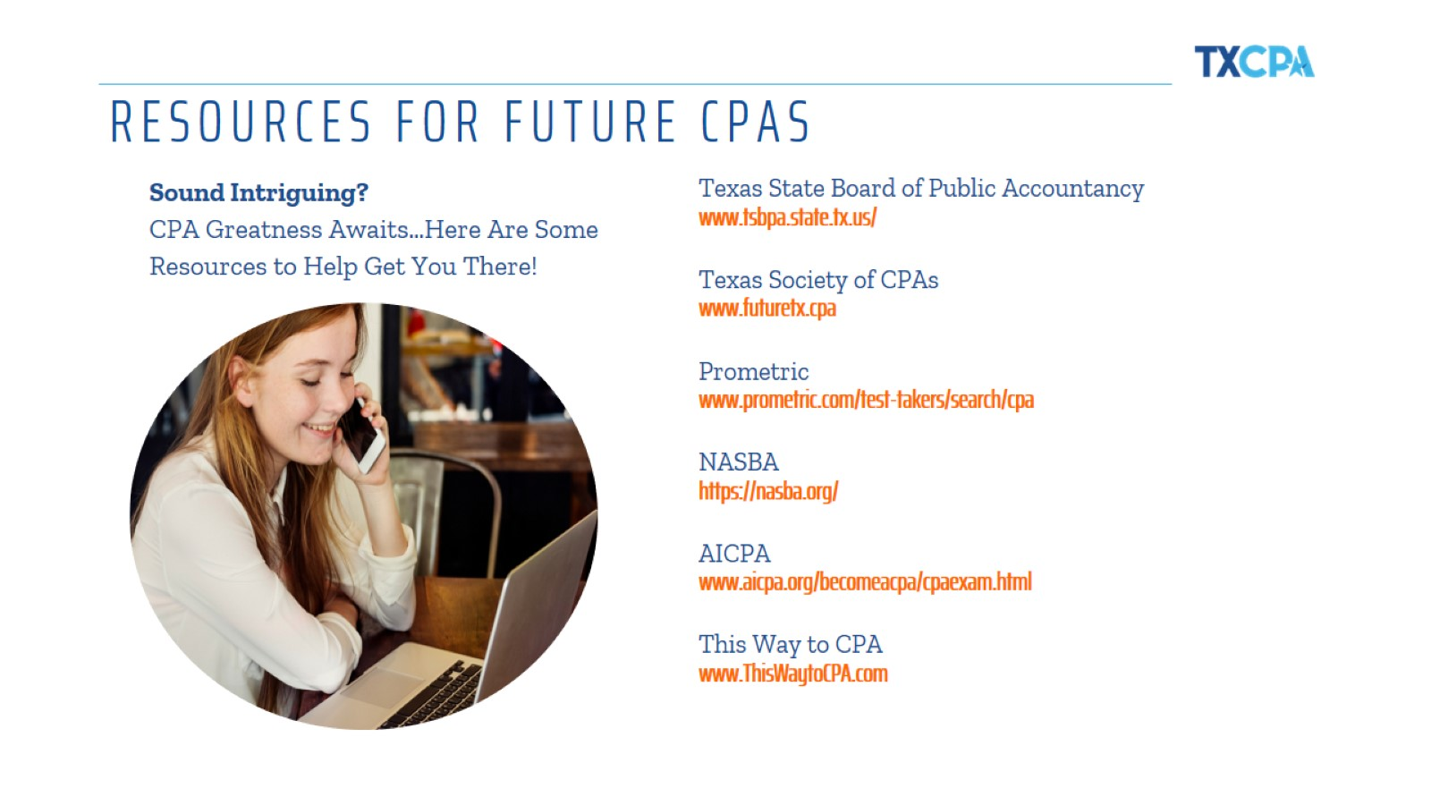
Notes:
I’ve shared a lot of information about the profession with you today! I would keep this list of resources handy as you make further decisions about your career and if you want to know more about a career in accounting.
Please remember you have the support of TXCPA and our committed volunteers here in the local chapter and across the state to help however we can.

Slide 24

Notes:
I know this was a great deal of information and you have time to make decisions about your career. Again, my hope is that my experience and the many options in the field may have given you the accounting bug! It is truly an awesome career and one to consider when the time is right!
Now I want to hear more from you! What questions do you have?

Slide 25

Notes:
We’re always sharing and adding new information for future and current CPAs on our social media channels.
Please connect with us to stay informed on all things CPA and Texas. We’re on all of these platforms you see here.

Slide 26

(Name)
(Job Position)
(email)
(Chapter Name)
(Chapter Phone)
(Chapter website)
Notes:
If a question pops in your head that didn’t get asked today, please don’t hesitate to reach out to [insert your contact information, or TX.cpa, or chapter representative].

