Slide 1

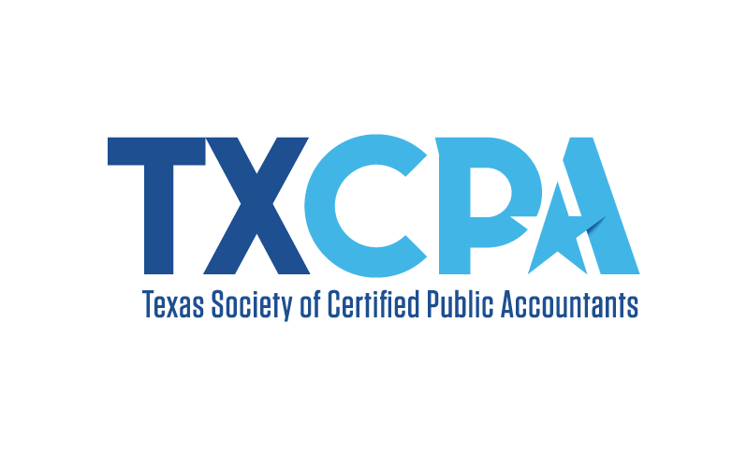
ACCOUNTING CAN TAKE
YOU ANYWHERE…
WHERE DO YOU WANT TO GO?
(SPEAKER NAME) | (COMPANY) | (TITLE)
(HIGH SCHOOL NAME/LOCATION)
(DATE)
Notes:
Good morning/afternoon everyone,
Today’s a good day because I get to tell you more about the profession I know and love, the endless opportunities that await you in accounting and as a CPA, as well as what it takes to get there.
Who knows what CPA stands for? Wait for an answer Certified Public Accountant.
I am a CPA and look forward to telling you a little more about my career journey. My name is [insert name] and I am a [position/title] at [firm/organization]. Believe it or not I once was sitting where you are now trying to figure out what I wanted to do with my life! My hope is that telling you a bit more about how I got to where I am and some specifics about the career will help you consider accounting and a future as a CPA – while dispelling any of your preconceived notions about the profession.
Possibilities for telling your journey:
Why you decided to become a CPA.
Where did you go to school?
How/when did you take the exam? Did you pass/fail?
Words of wisdom you received or learned that could help them through the journey.

Slide 2
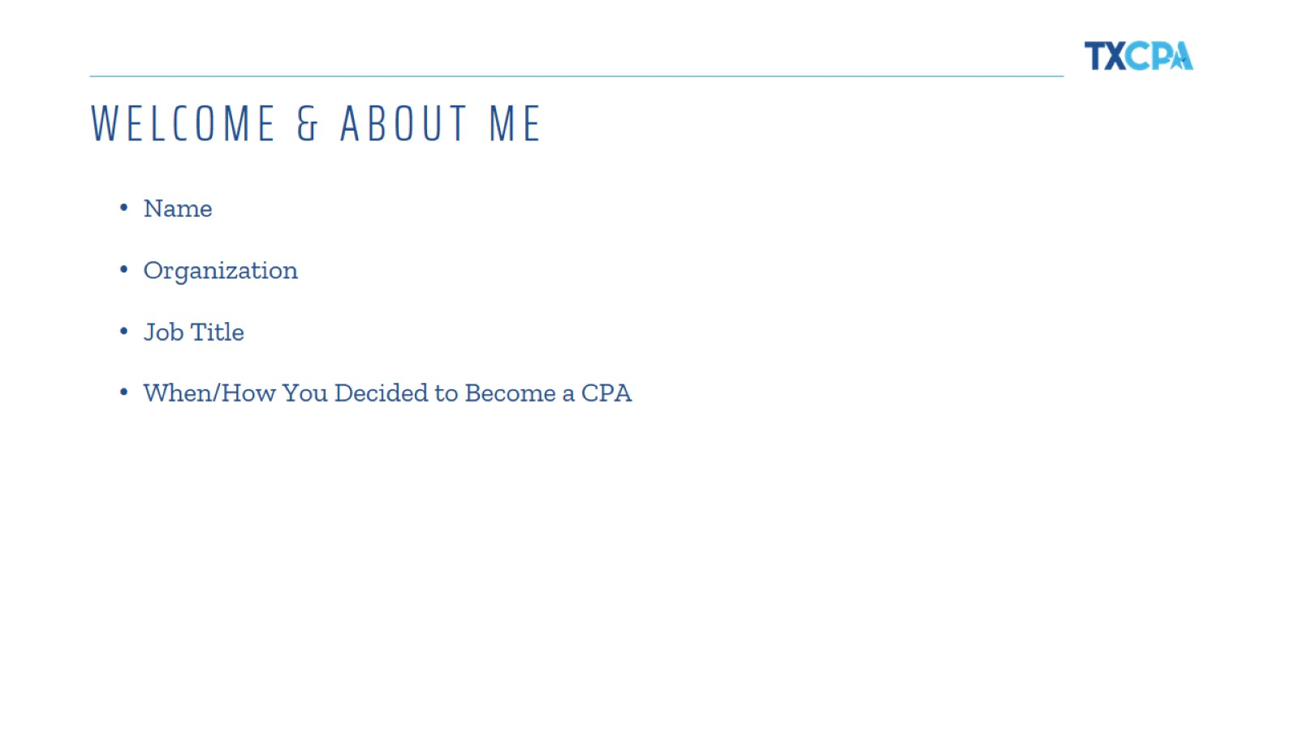
WELCOME & ABOUT ME
Notes:
Talk about yourself and your background here. Feel free to add more slides, photos, information, etc. This is where you tell your personal career story and what led you to become a CPA!

Slide 3

Notes:
(Optional Activity) Now that you know a bit about me, let me find out a bit about you!
Ask students to choose any 5 skills from the grid on the next slide. Give them 2-3minutes to note it down in their notebook.
Call on 2-3 students and get a few responses. Make sure to applaud the student for choosing those skills.
Now connect one of the skills they chose to how that skill can help make them as a good accountant.
Example: Compassion is such a strong skill to have to be a good accountant. We work with different clients all the time and understanding their situation and providing them the right help is crucial. Followed by giving an example from your work.

Slide 4
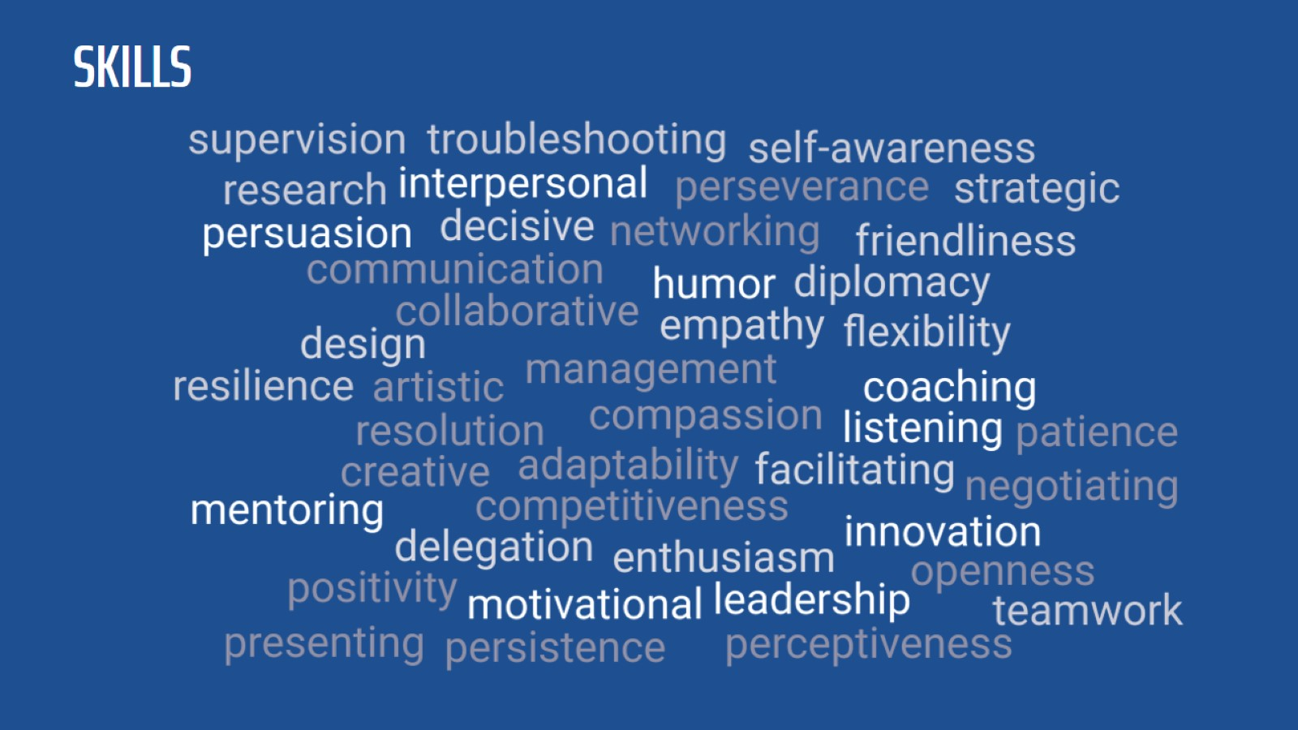
Notes:
Presenter Tip: Prepare 2-3 concrete examples for a few of these skills in advance. Select skills that reflect the work you do.
Example: Collaborative abilities: As an accountant/CPA I work with multiple clients and manage 2-3 people in my team. Example: I was working on ABC project. It was good to have a team that had different ideas to help the client. We did XYZ.

Slide 5
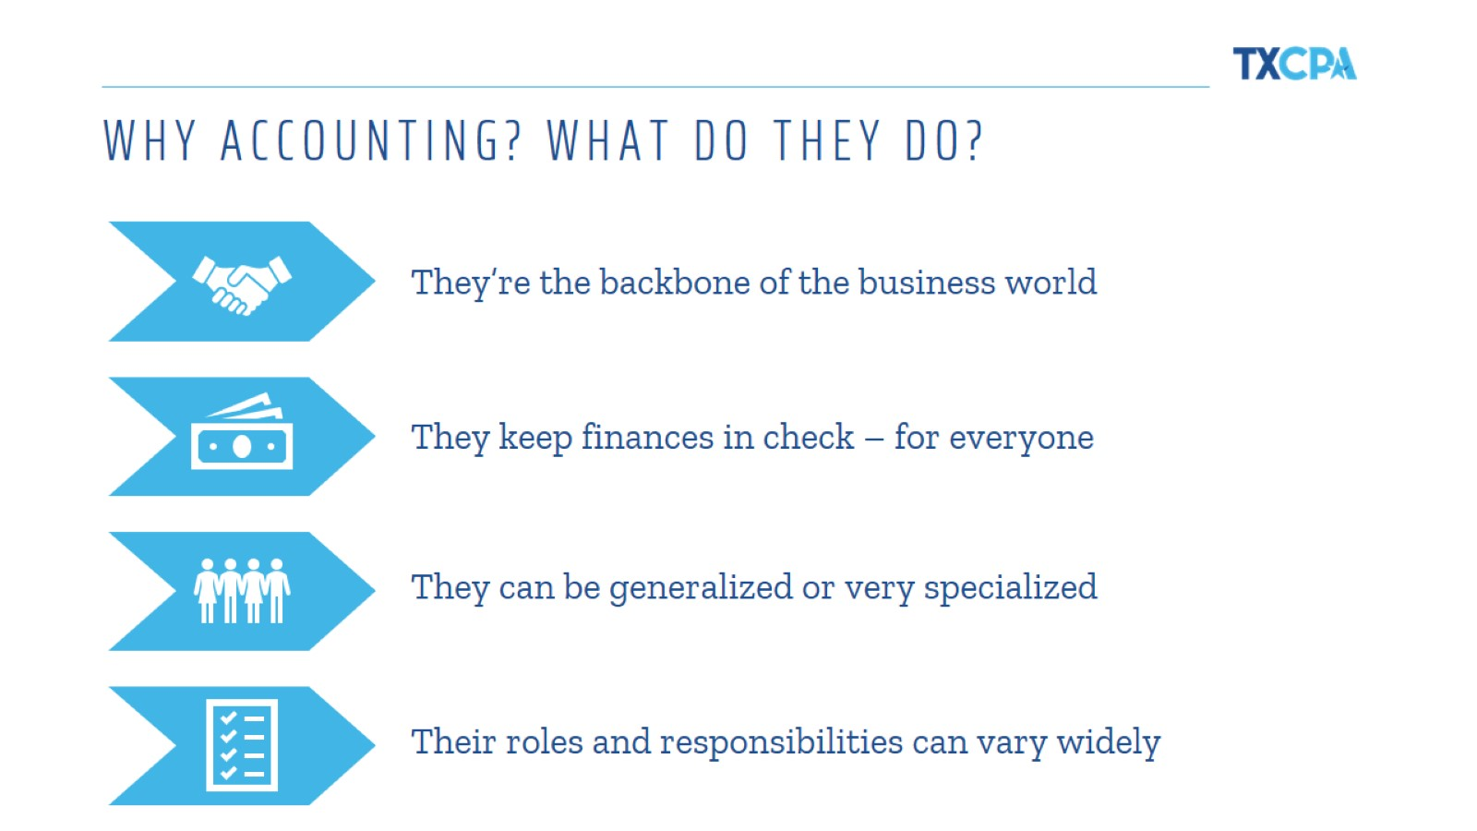
WHY ACCOUNTING? WHAT DO THEY DO?
Notes:
So, why are accountants and CPAs a big deal? Well they are the backbone of the business world, and often lead the business world! They make sure all finances are in check for individuals and businesses. They are respected, trusted and admired by many for the impact they have in their community and the business they work for.

Slide 6

Notes:
(Optional Activity) Get students excited to play a game! Ask students to raise their hand to answer. Move to the slide with the logos.
Step 1: Student A guesses Adidas. Student B guesses Nike.
Step 2: Student C says which one is their favorite.
Go around the class giving multiple students a chance to participate. If the logo is too obvious, let students choose their favorite .
At the end of the slides, ask students: What do you think all these companies have in common? Share that there are accounting professionals that work for all these companies!

Slide 7

Notes:
Adidas
Nike

Slide 8

Notes:
McDonald’s
Wendy’s

Slide 9

Notes:
Apple
Microsoft

Slide 10

Notes:
Dunkin’ Donuts
Starbucks

Slide 11

Notes:
Mercedes Benz
BMW

Slide 12

Notes:
American Airlines
Delta

Slide 13

Notes:
Mastercard
Visa

Slide 14

Notes:
Netflix
Prime Video

Slide 15

Notes:
PlayStation
Switch

Slide 16
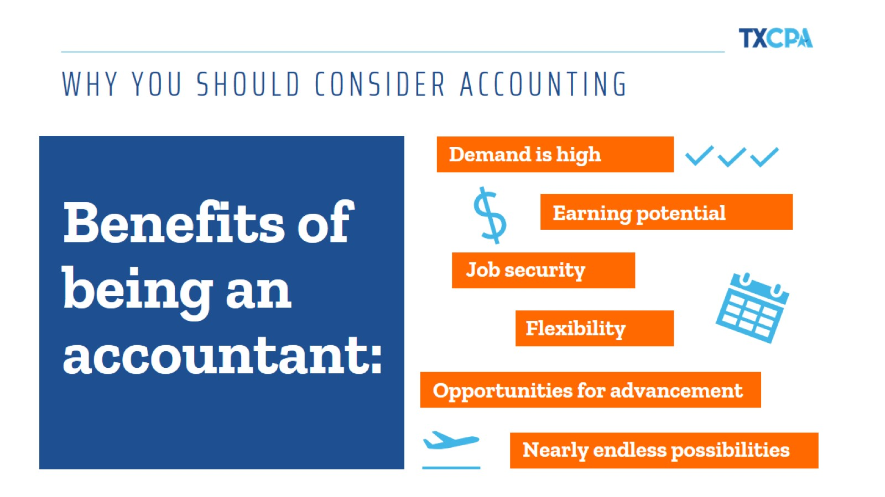
WHY YOU SHOULD CONSIDER ACCOUNTING
Notes:
There are so many reasons why you should consider this profession, but I would be here all day and I doubt you would want that! So I will delve into just a few a bit more!
Demand: There are more positions than skilled accountants to fill them. As organizations are becoming more and more globalized, the need for skilled accountants—especially those with diverse backgrounds and experiences—is only going to continue to grow.
Earning potential: Those who work with money bring home a good amount, too. According to the 2017 Robert Half Salary Guide, Junior-level accountants in large firms make between $69,250-$90,000 per year. Those with more experience make far more than that—we’re talking six, or even seven, figures!
Job security: It’s one of the most recession-proof careers out there. While changes in the economy tend to have a direct impact on many professions, money matters are often even more critical when the market isn’t as hot. This affords many accountants much greater job stability regardless of what’s going on in the world.
Flexibility: Work/life balance is a priority for big accounting firms. According to an article by the New York Times, big accounting firms have done the math and seen that creating better work/life balance for employees is financially beneficial. Plus, much of the work accountants do can be done from anywhere, which makes managing life and deadlines much easier and helps prevent burnout.
Opportunities: Prove yourself and the sky’s the limit. Accountants hold everything from entry-level jobs to CFO positions and everything in between. Depending on what route you decide to take, promotions can come on a fairly regular basis and offer even more opportunity to focus on the aspects of your job that interest you the most.
Possibilities: Accountants do many different things in every industry. Accountants work in every industry under the sun. So whatever you’re into—whether it’s food, photography or football—there’s a professional who accounts for it. That means if you decide as an accountant that you want to mix things up, there’s always another industry or position that’s ready to welcome you with open arms.

Slide 17
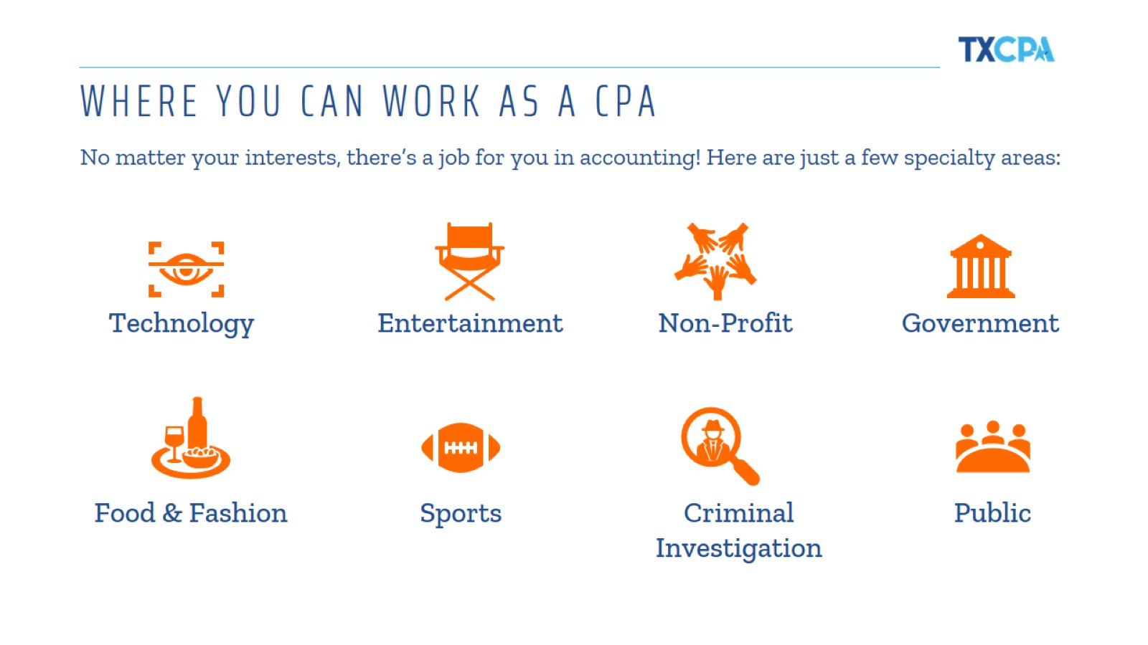
WHERE YOU CAN WORK AS A CPA
Notes:
CPAS: KEEPING EVERY INDUSTRY ON TRACK – These are just Some of them!
Accountants are behind pretty much every sound financial decision and have become some of the most important decision makers in business. Because they understand their companies inside and out, they often hold the all the answers!
There are also tons of cool jobs for CPAs you may not even know about. Like financial forensics. Join the FBI or other law enforcement agencies and you could help investigate and stop white-collar financial crimes.
Are you a pop culture junkie, movie addict or die-hard music fan? Turn your love of entertainment into a career as a CPA for big name stars, movie studios, musicians and authors.
You dream it, you can be it or be the CPA for it! There is truly endless possibilities with this career.

Slide 18
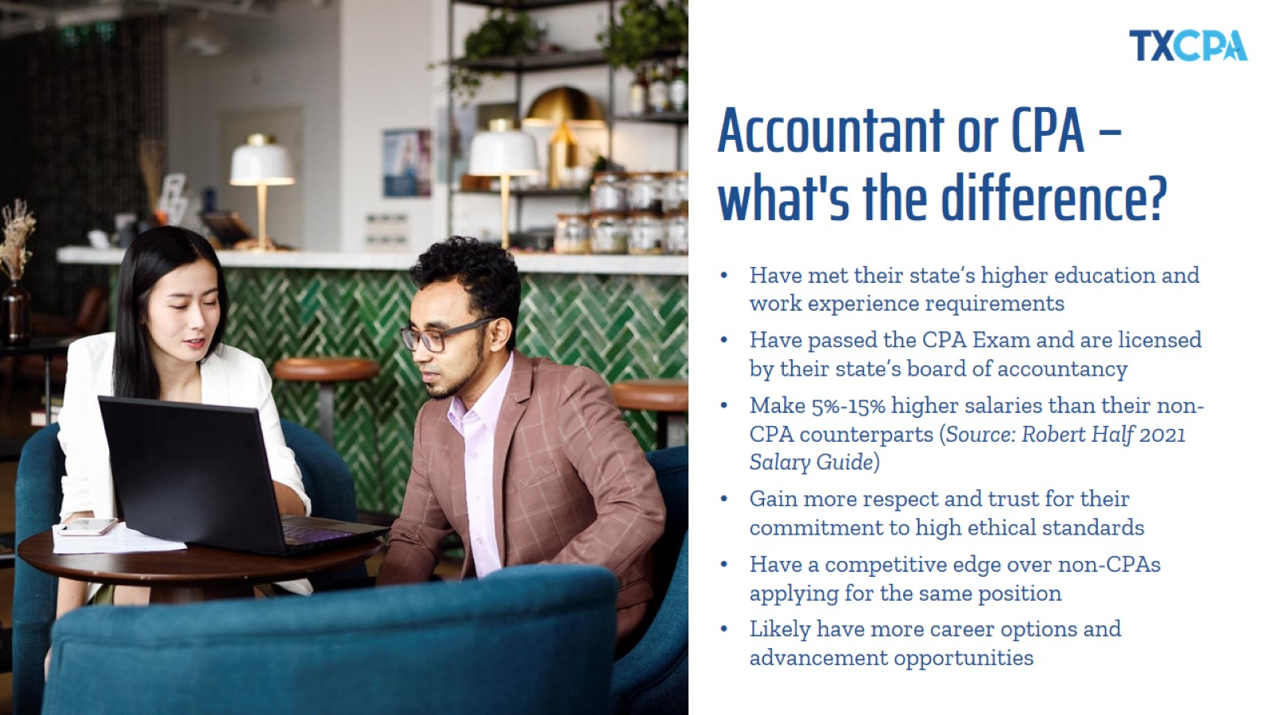
Accountant or CPA – what's the difference?
Notes:
I decided to become a CPA [insert your reason]!
While all CPAs are accountants, not all accountants are CPAs. CPAs are accountants who are certified. CPA stands for Certified Public Accountant. A CPA is a trusted advisor to individuals, businesses, and other organizations, helping each achieve their financial dreams and goals. Whether advising businesses on multi-million-dollar acquisitions, auditing companies’ 401K plans, or helping people invest for retirement, a CPA’s adherence to a strict code of ethics along with accounting and finance expertise allows the public to put their trust in CPAs.
To become a CPA, they had to meet their state’s experience and education requirements, pass 4 sections of the CPA Exam and, in Texas and some other states, complete an ethics requirement as well.

Slide 19
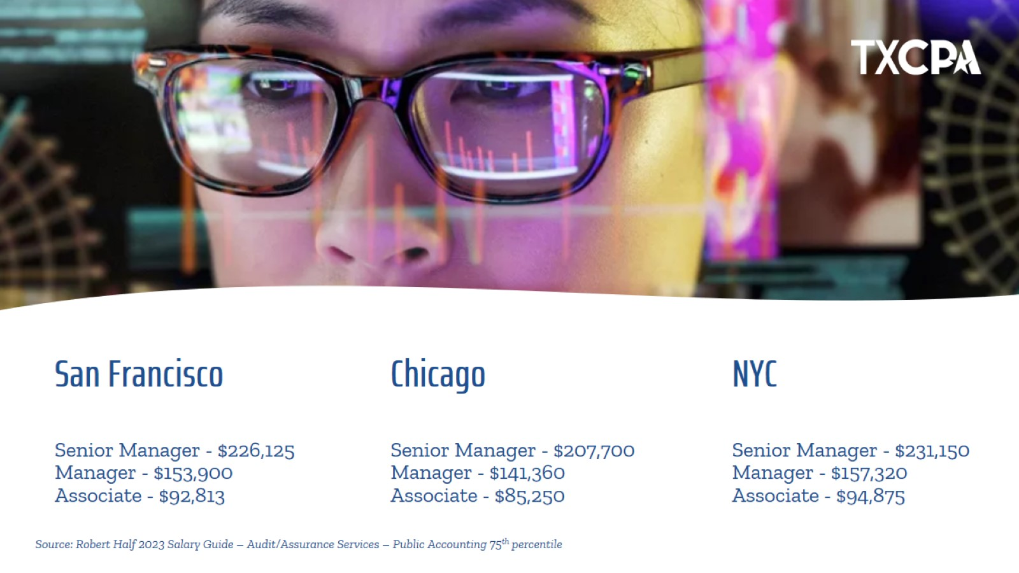
San Francisco
Senior Manager - $226,125
Manager - $153,900
Associate - $92,813
Notes:
And accountants make good money. The salaries referenced here are from the Robert Half Salary Guide – Audit/Assurance Services in Public Accounting, and represent the 75th percentile. National Averages can be found below. Stay the course and make Partner, and start around $400K+ per year.
National Average
Senior Manager - $167,500
Manager - $114,000
Associate - $68,750

Slide 20
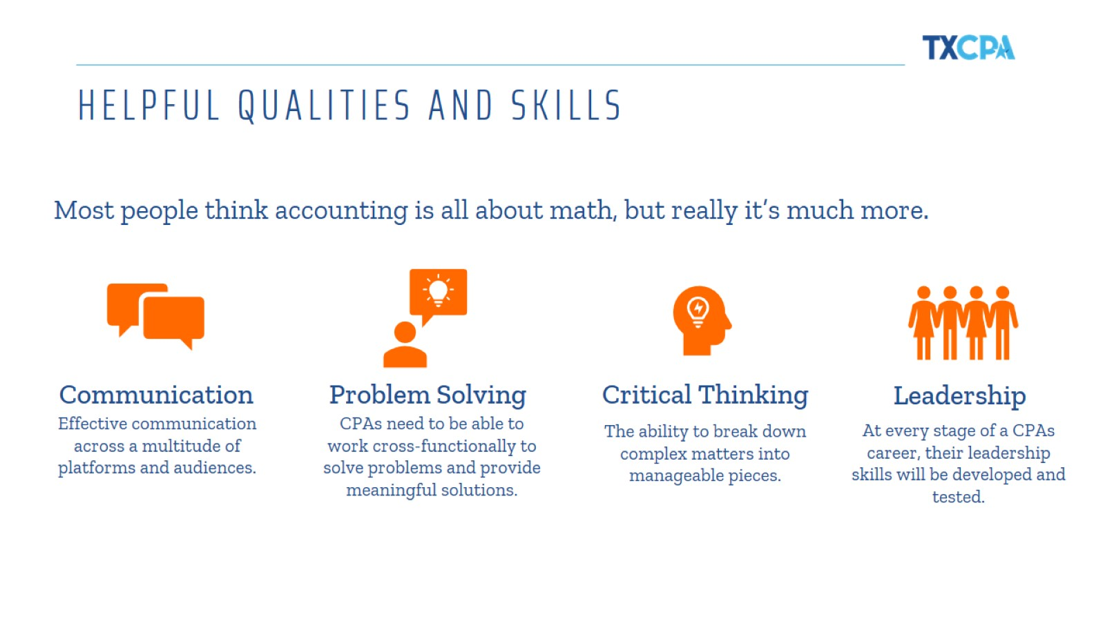
HELPFUL QUALITIES AND SKILLS
Notes:
Since the CPA profession is constantly evolving, just like you, we never stop learning. In fact, CPAs are required to meet education requirements as part of our license renewal process.
When you look at this list of skills, you might not immediately think they are accounting or business related or that they are skills beneficial in the field. But communication, problem solving, critical thinking and leadership are all important and necessary as a CPA.
I’d encourage you to broaden your scope and take advantage of any opportunities you find to add these to your list of talents now and in the future.
[Provide an example when you’ve used one (or more!) of these skills in your job]

Slide 21

Could accounting be right for you?
Notes:
So, could accounting be right for you?
Presenter Tip: Make this part interactive and ask the students to raise their hand for each question they relate to.
If this sounds like you, explore accounting!

Slide 22
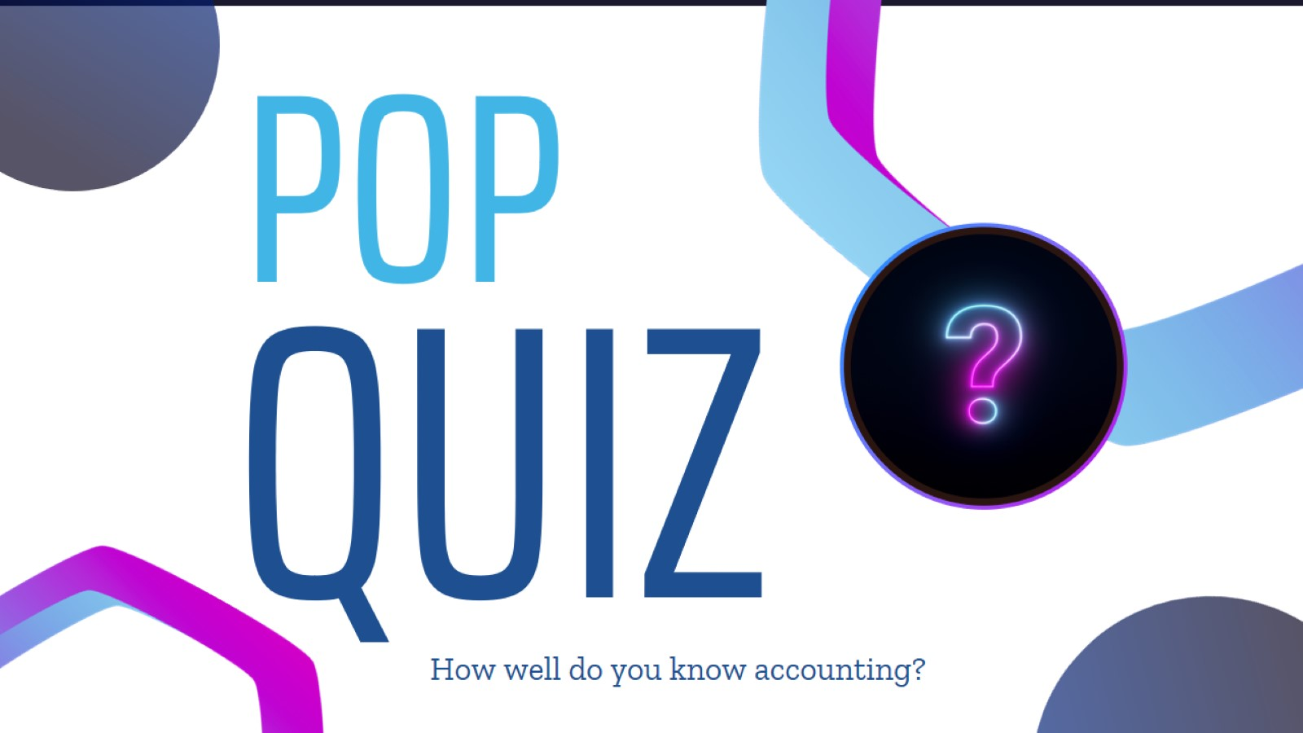
Notes:
(Optional Activity) Let students raise their hands and answer the questions! This is a great time to give out swag/candy for correct answers. Let everyone get a chance to answer.

Slide 23

Notes:
Certified Public Accountant

Slide 24

Notes:
Accountants

Slide 25
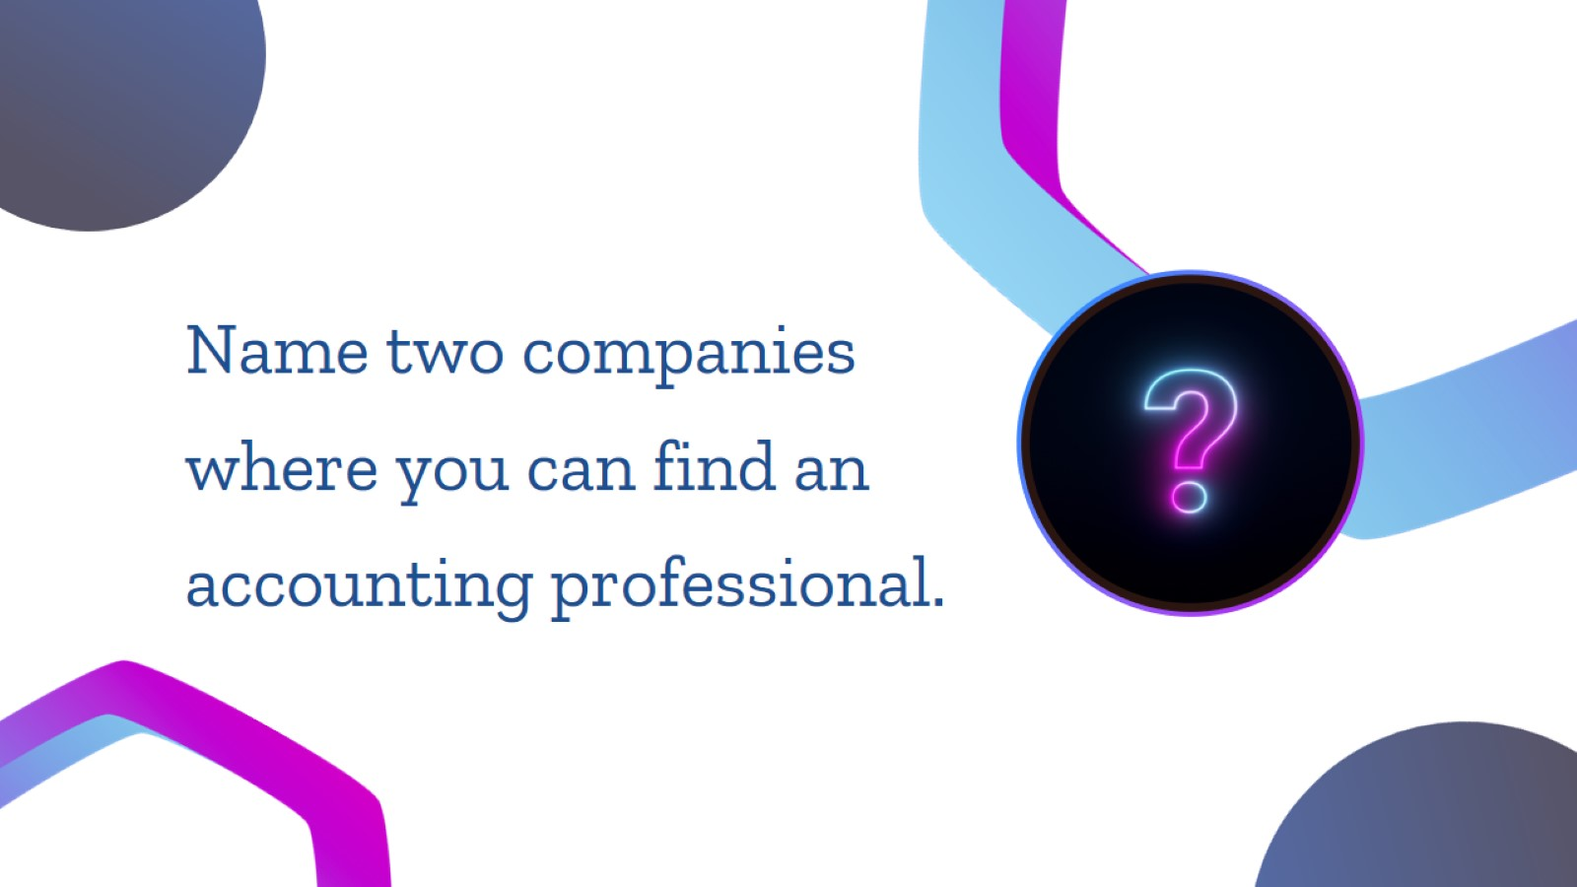
Notes:
Students can answer any company. Example: Nike, Wendy’s, Apple, etc.

Slide 26
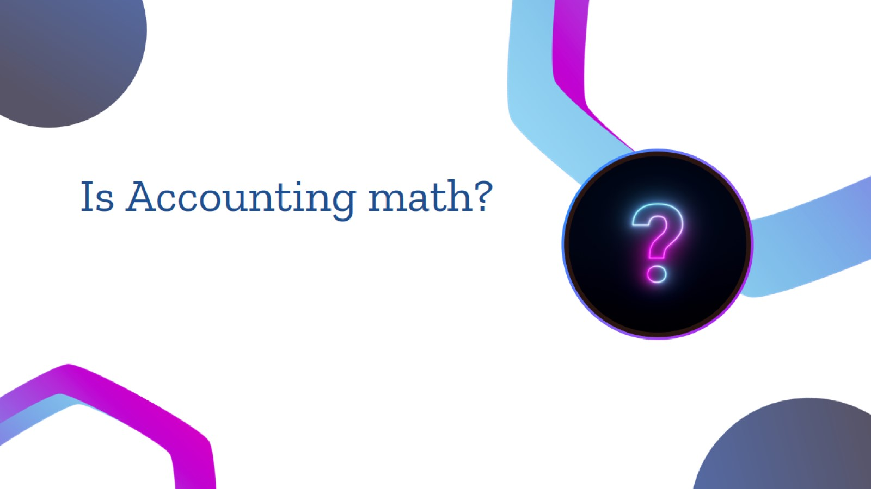
Notes:
NO, it’s Money!

Slide 27

Notes:
Entrepreneur, CFO, Forensic accountant, Financial planner, etc.

Slide 28

Notes:
I know this was a great deal of information and you have time to make decisions about your career. Again, my hope is that my experience and the many options in the field may have given you the accounting bug! It is truly an awesome career and one to consider when the time is right!
Now I want to hear more from you! What questions do you have?

Slide 29

Notes:
If a question pops in your head that didn’t get asked today, please don’t hesitate to reach out to [insert your contact information, or TX.cpa]

