Slide 1

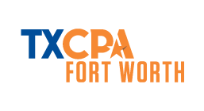
OPPORTUNITIES IN ACCOUNTING
A presentation of
Fort Worth Chapter, Texas Society of Certified Public Accountants
www.tx.cpa/fortworth/students
Notes:
Agenda
4 minutes: Your self-introduction
15 minutes: pathway to a career in accounting
4 minutes: discussion using questions at last PowerPoint slide
2 minutes: closing evaluation

Slide 2

Your Presenter Today
Notes:
No more than 4 minutes
Give your narrative about your education and experience.
If your education began at a community college, be sure to mention that.
If you don’t have a narrative about your education at the ready, complete these sentences:
I grew up thinking I wanted to be …
I started college at [name of school] and finished [#] years later at [name of school] with a [name degree].
I first started working in the accounting profession [doing what]
Now, my work is …
To me, the best part about being a CPA is …
I never thought my career as a CPA would involve …
Here’s why I value my CPA certificate in my career…

Slide 3
What is a CPA?

Slide 4
CPA = certified public accountant
License is controlled by the states
Myths about CPAs:
  “CPAs only do taxes.”
  “IRS is in charge of accountants.”
  “You have to be good at math to be a CPA.”
  “You sit in the same office all day everyday.”
Notes:
Certified = the government licenses
Public = licensed to serve the public
Accountant = have mastered a defined body of knowledge
Licensing by the state establishes
Qualifications for entry into the profession
Assurance that those who are holding themselves out as professionals have those qualifications
Myths about CPAs:
“Doing taxes” does not require a CPA license, nor do all CPAs provide tax compliance service. There are many other things CPAs are trained to do.
The Internal Revenue Service does manage the qualifications of people who provide paid tax preparation service, but they don’t license CPAs
Doing math is not a big part of accounting; working with dollars is. Much of the math involves directing information technology.
Many CPA’s travel to clients, to trainings, to different office locations, etc.; many work from home

Slide 5
Did You Know…
Janet Jackson and Mick Jagger studied to be an accountant
Phil Knight, the founder and chairman emeritus of Nike, is a CPA
Thomas Pickard, former acting Director at the FBI, is a CPA
Arthur Blank, co-founder of Home Depot and owner of the Atlanta Falcons, is a CPA
John Grisham has an accounting degree
Kevin Kennedy, former Texas Rangers manager, is a CPA (in the minors he did his players’ tax returns)
Gary Kelly, chairman and CEO of Southwest Airlines, began his career as a CPA
Tim DuBois, the “Singing Accountant”, wrote Love in the First Degree (Alabama), She Got the Goldmine, I Got the Shaft (Jerry Reed) and When I Call Your Name (Vince Gill). Now he’s president of Arista Records
The most senior elected official in Tarrant County, Judge Glen Whitley, is a CPA

Slide 6
BENEFITS OF THE CPA CREDENTIAL

Slide 7
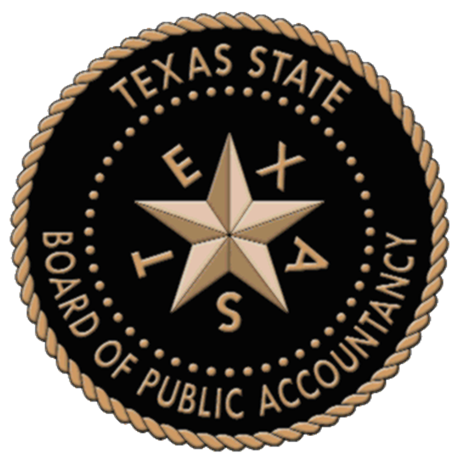



REASONS TO BECOME A CPA
According to a 2015 independent research study conducted by AICPA:
the CPA credential is second only to MD in professional esteem
CPAs are the most-trusted advisors to business owners
they are also known for high level of integrity and competency
Source: AICPA Insights article “CPA Brand Research: The Good, the Challenge and the Opportunity,” May 10, 2016
Notes:
Prestige and Respect
Job Satisfaction and Benefits
Career Security
Personal Growth
Money and Benefits

Slide 8


STRENGTH OF THE CPA CREDENTIAL
According to the DOL’s Bureau of Labor Statistics:
Accountants and auditors who have earned professional recognition, especially as Certified Public Accountants (CPAs), should have the best prospects
A CPA license paired with an MBA with a concentration in accounting may have an advantage
Employment of accountants and auditors is projected to grow 10 percent from 2016 to 2026, faster than the average for all occupations
Source: Bureau of Labor Statistics, U.S. Department of Labor, Occupational Outlook Handbook, Accountants and Auditors,
on the Internet at https://www.bls.gov/ooh/business-and-financial/accountants-and-auditors.htm (visited March 28, 2019).

Slide 9
ACCOUNTING CAREERS

Slide 10

EMPLOYMENT OPTIONS
Having a CPA license can open a lot of doors!
You can work in:
  a CPA firm
  industry, for a public or private company
  government
  education – PhD in accounting needed
  financial markets
  a management path
Notes:
As a CPA, you can work in ANY industry that interest you since ALL companies need an Accountant
Assurance and Attestation Services
Corporate Finance (Merger & Acquisition, initial public offerings, share & debt issuance)
Estate Planning
Financial Accounting
Financial Planning and Analysis
Management and Cost Accounting
Forensic Accounting (preventing, detecting, and investigating financial frauds)
Information Technology, especially as applied to accounting and auditing
Consulting & Performance Management
Tax Preparation and Planning
Venture Capital
Financial reporting
Regulatory reporting
Corporate Governance
Research and Technical Writing

Slide 11

EMPLOYMENT OPTIONS
  your own company – work for yourself!
Notes:
For CPAs with good leadership skills who desire a greater degree of freedom, firm ownership can be an attractive career option.
According to the editor-in-chief of MiLLENNiAL magazine, 60% of Millennials see themselves as entrepreneurs, while 90% say they have an entrepreneurial mindset.

Slide 12
THE WORLD NEEDS SKILLED ACCOUNTANTS
$58,250
$95,000
Here are just a few examples of what
they’re willing to pay to get them:
Internal auditor
$106,250
$201,500
$60,500
$113,000
Controller
Senior tax accountant (public)
$84,750
$161,500
$76,000
$144,750
Financial analyst manager
Forensic accountant
$168,750
$500,000
Chief financial officer
*Source for all salary ranges: Robert Half, 2019 Accounting & Finance Salary Guide
Bonus: You can add up to 15% to these salaries with a CPA license!

Slide 13
Financial Rewards Comparison
Recent estimate by TXCPA
  Degreed accountant who is NOT a CPA:
  Lifetime earnings $4.0 million
  Accountant who is a CPA:
  Lifetime earnings of $5.0 million
CPA license makes a big difference in lifetime earnings
Notes:
Lifetime earnings comparison: CPAs earn more than degreed accountants over a lifetime
A degreed accountant, with good experience, must utilize that experience—in essence, sell his/her resume—every time he/she wants a new job
In a voluntary move, that’s one thing; in an involuntary move, that’s tough
Versus: with a CPA, even in industry, a leg up on those with only experience—many positions have CPA license as a requirement and many C level positions require the credential.
A word about STARTING SALARIES: a global staffing firm called Robert Half produces statistics about salaries for accounting professionals. Here’s what they say about starting salaries in public accounting—which is where most people who aspire to become CPAs begin out of school.
They say starting salaries for those entering medium sized accounting firms range from $46,325 to $98,100. I can attest to the fact that the midpoint starting salary in public accounting in Fort Worth is in the $40,000.
And salaries are strong in industry, too, where you might not need a CPA going in—but you can expect a 10% bump in salary for holding a CPA certificate.

Slide 14
Rewards
Flexibility: variety of work environments, employment arrangements, entrepreneurial opportunities
Security: power of a highly-regarded credential, supported by a stiff regulatory system and public confidence
Competitive financial rewards
Seen as a Trusted Advisor to Management
Notes:
So why would you take on this profession?
Requires an advanced skill set, dedication to a higher level of behavioral standards, compliance with a regulatory system, more investment in education. Why do it?
Many reasons:
Flexibility— many career paths
SECURITY—portable, state to state; provides a proven credential to establish trust and credibility in a work environment, in a client service environment
Competitive financial rewards = good earning power

Slide 15

TALENT GAP CREATING PRESSURE
  55 million job openings through 2020
  Demand for specialization
  Workforce requires more “soft” skills
  Contingent workforce
Boomers taking with them:
  Leadership
  Contacts
  Legacy knowledge
  Functional skills
  Non-technical attributes

Slide 16
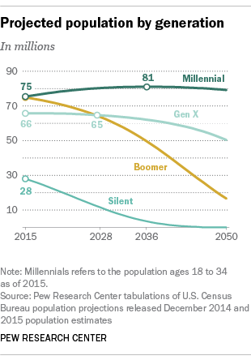
MILLENNIALS OVERTAKE BOOMERS
Notes:
According to Texas State Board of Public Accountancy data (Dec. 2018):
50 percent of Texas CPAs are over the age of 50
over 20 percent of those CPAs are over 65
According to a TXCPA demographic profile report from Dec 2018:
53 percent of TXCPA members are over the age of 50
Retiring CPAs mean upcoming opportunities for new talent to enter the marketplace

Slide 17
Security: Power of the Credential
CPA profession is well-organized to protect its interests
Of approximately 700,000 CPAs nationwide, about half are members of the AICPA
Professional associations—like AICPA and TXCPA—work to advance members’ success
CPAs are in one of the top recession proof careers
Notes:
Accounting profession is regulated—you must comply with state license requirements
The flip side: the accounting profession is also well organized to advocate for its interests in the regulatory environment
THIS IS A PLUS in a career choice because it means that over your career, as a CPA you’ll have an organized entity helping protect your interests
There is a very active CPA PAC (Political Action Committee) that is active at both the state and national level

Slide 18
HIRING TRENDS

Slide 19
HIRING TRENDS
HOT AREAS & SPECIALTIES WITHIN THE ACCOUNTING PROFESSION ARE:
Employment of accountants and auditors to grow faster through 2024 than the average for all occupations
Accounting manager
Controller
Financial analyst
Internal auditor
Payroll manager
Senior accountant
Staff accountant
  Source: Bureau of Labor Statistics, U.S. Department of Labor, Occupational Outlook Handbook, 2016-17 Edition.
Source: 2019 Robert Half Salary Guide

Slide 20
EXPANDED AREAS OF ASSIGNMENT
AICPA’s 2017 Trends Report has an expanded list of assignment areas for new graduate hires in public accounting:
Assurance
services
45 %
36%
Consulting
7%
5%
2%
2%
Auditing
Taxation
Information management and technology assurance
Financial
Accounting
Other Areas | 1%
Management Accounting | 1%
Transaction Services | 1%
Financial Forensics | 0.3%
Business Valuation | 0.1%
Personal Financial Planning | 0.1%
Source: 2017 AICPA Trends Report

Slide 21


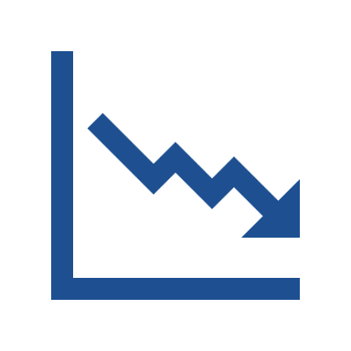

HIRING TRENDS
DIGITAL TRANSFORMATION’S EFFECT ON HIRING
17%
59%
9%
3%
12%
of companies are expanding staff levels
of companies are maintaining staff levels
of companies are freezing staff levels
of companies are reducing staff levels
not sure
Source: Benchmarking Accounting and Finance Functions; 2018, Robert Half and Financial Executives Research Foundation; based on responses from financial leaders in the United States

Slide 22
EMPLOYER AND MARKETPLACE NEEDS

Slide 23

EMPLOYER AND MARKETPLACE NEEDS
According to the 2019 Robert Half Salary Guide,
in-demand technology skills for recent graduates include:
Artificial intelligence
Cloud-based systems (NetSuite, Workday)
Construction project management software (SQL,VBA)
Enterprise resource planning systems (Microsoft Dynamics GP, Oracle, SAP)
Excel
QuickBooks (for small and midsize businesses)
Real estate software (MRI, Yardi)
Robotic process automation

Slide 24
GROWING SKILLS DEMAND
Analytical thinking and innovation
Active learning and learning strategies
Creativity, originality and initiative
Technology design and programming
Critical thinking and analysis
Complex problem-solving
Leadership and social influence
Emotional intelligence
Reasoning, problem-solving and ideation
Systems analysis and evaluation
By 2022, everyone will need an extra 101 DAYS OF LEARNING
Source: World Economic Forum Future of Jobs, 2018

Slide 25
Requirements

Slide 26
CPA Skill Set
Strong communication abilities: writing, speaking; selecting appropriate media
Problem solving, analytical, and research skills
Good time management skills
Leadership abilities: offering a vision, encouraging others to follow and participate
Identify and implement emerging technologies
Notes:
What skill set is beneficial to becoming a CPA?
We will talk in a few minutes about the educational requirements—but here’s an important concept—CPAs do not just analyze and manage technical accounting data.
They are required to be capable communicators regarding the problems and analysis they see; they must be capable of explaining issues and solutions, and even advocating for those solutions.
Therefore, the licensing and qualifications schemes in place require that CPAs gain skills in these areas: (list on slide)

Slide 27
Education Requirement
Four-year undergraduate degree
One year of additional study which may entail a master’s degree
Total 150 college credit hours
For most: 150 hours = five years
“Fifth year” scholarships available through funding by CPA license fees
  Link to scholarship info: tx.cpa/fortworth/students
Notes:
These requirements are established by the Texas State Board of Public Accountancy.

Slide 28
Examination and Experience Requirements for Licensure
National computerized examination, four parts
  Auditing and attestation
  Business environment and concepts
  Financial accounting and reporting
  Regulation
Experience under direction of a CPA
Then, to maintain the license:
40 hours of education annually
Notes:
Give your experience with the exam, whether it was pencil or computer based.
Note that although the exam is difficult, there are many resources for study materials that aid in preparing for the test – and some employers cover or reduce the cost of these products.

Slide 29
Mapping a Path to CPA
American Institute of CPAs website for community college students
www.StartHereGoPlaces.com
Notes:
You can get information from this site about how your work here at TCC can lead to a bachelor’s or master’s degree from a school like UT Arlington, that offers the credits necessary to sit for the CPA exam
Caution! As you plot out your course work, heading for a four-year degree, be sure to check with the institution to which you’ll be attempting to transfer your credit
Also: the Texas State Board of Public Accountants sets the rules for taking the CPA exam in Texas. Their rules control!

Slide 30
TXCPA STUDENT MEMBERSHIP

Slide 31

STUDENT MEMBERSHIP
Thousands of current student members from different chapters across Texas
20
Notes:
Join us!
We have a rich 100+ year history, and we are focused on a bright future.
The students here today represent that future, and we want you to know how much we support you and want you to succeed.

Slide 32





RESOURCES FOR STUDENT MEMBERS
Membership and events in your local chapter
Listing membership on your resume for future employers to see your dedication
Access to TXCPA Exchange, our exclusive online member community and directory
Discounts from several exam review vendors
TXCPA’s publications and
e-communications
Notes:
The network is the biggest benefit we have to offer you! Join and get to know the accounting community in Fort Worth – and statewide!

Slide 33




WE’RE SOCIAL!
TWITTER
INSTAGRAM
@TXCPAs
@FortWorthCPAs
@texassocietyofcpas
@fortworthcpas
FACEBOOK
LINKEDIN
@TXCPAs
@FortWorthCPA
Texas Society of CPAs
TXCPA Fort Worth
Notes:
Links to these social networks are on our student webpage

Slide 34

JOIN TXCPA FORT WORTH TODAY
tx.cpa/fortworth/student

Slide 35
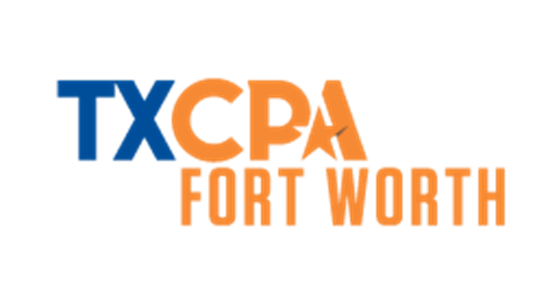
QUESTIONS?

Slide 36
THANK YOU!

