Slide 1


MONEY MANAGEMENT 101:
A GUIDE TO FINANCIAL BASICS
{NAME}
{COMPANY}
{DATE}

Slide 2


Slide 3

YOUR PAYCHECK AND SAVINGS

Slide 4

BE A SAVVY SHOPPER

Slide 5


Slide 6
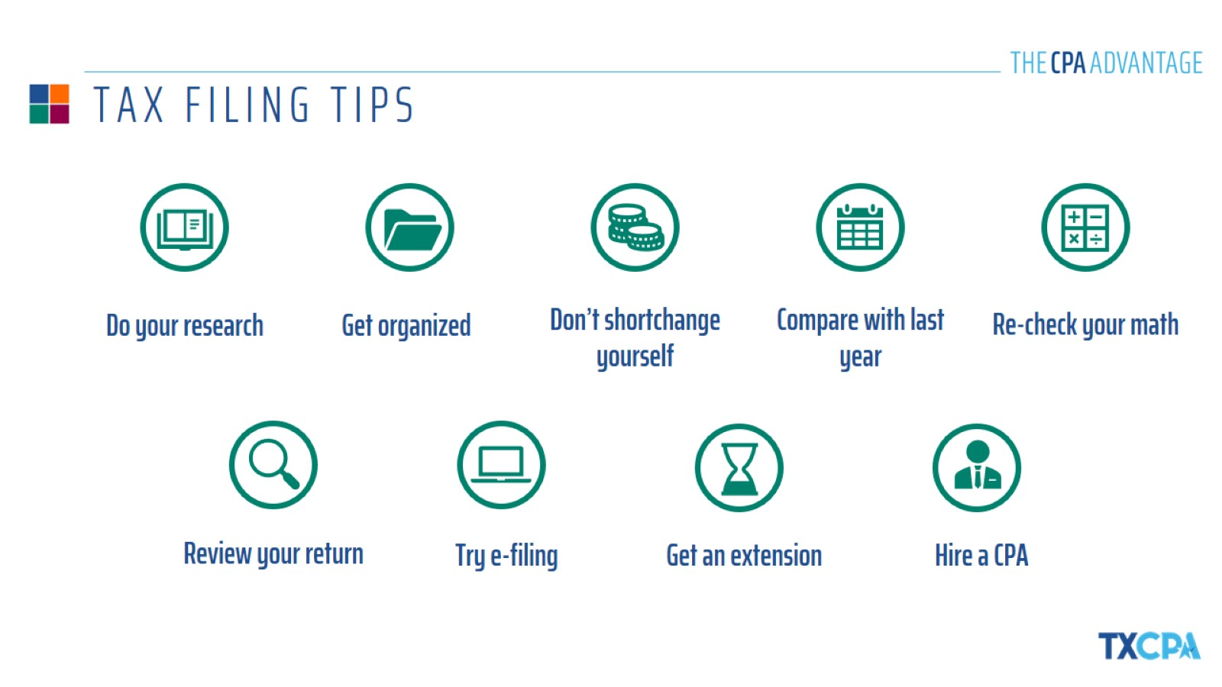
TAX FILING TIPS

Slide 7

THE MOST COMMONLY OVERLOOKED DEDUCTIONS

Slide 8


Slide 9
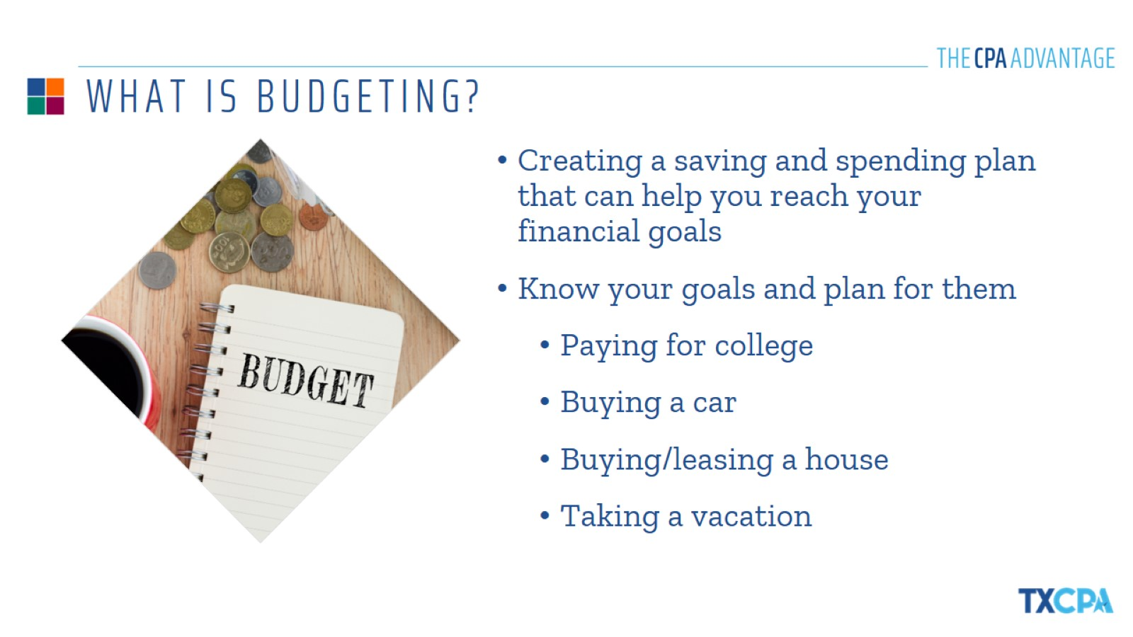
WHAT IS BUDGETING?

Slide 10
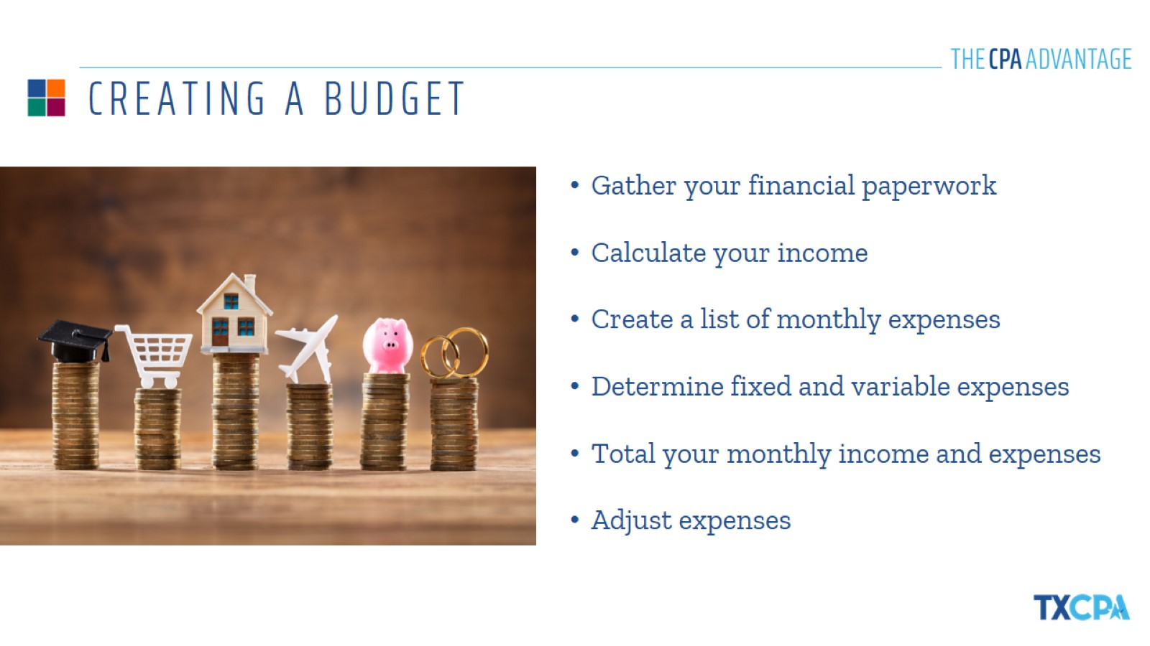
CREATING A BUDGET

Slide 11

KEEPING YOUR BUDGET ON TRACK

Slide 12


Slide 13
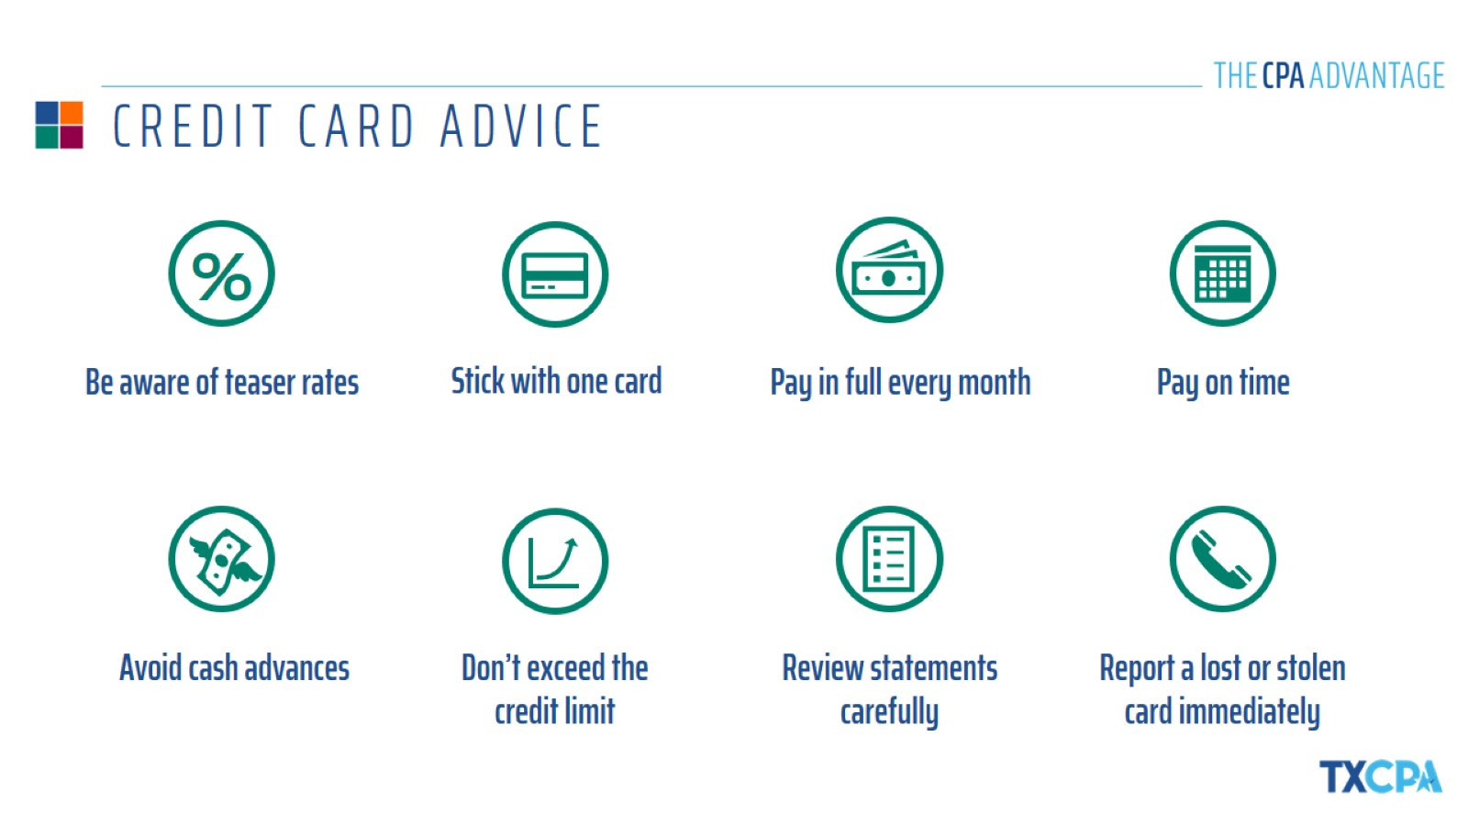
CREDIT CARD ADVICE

Slide 14
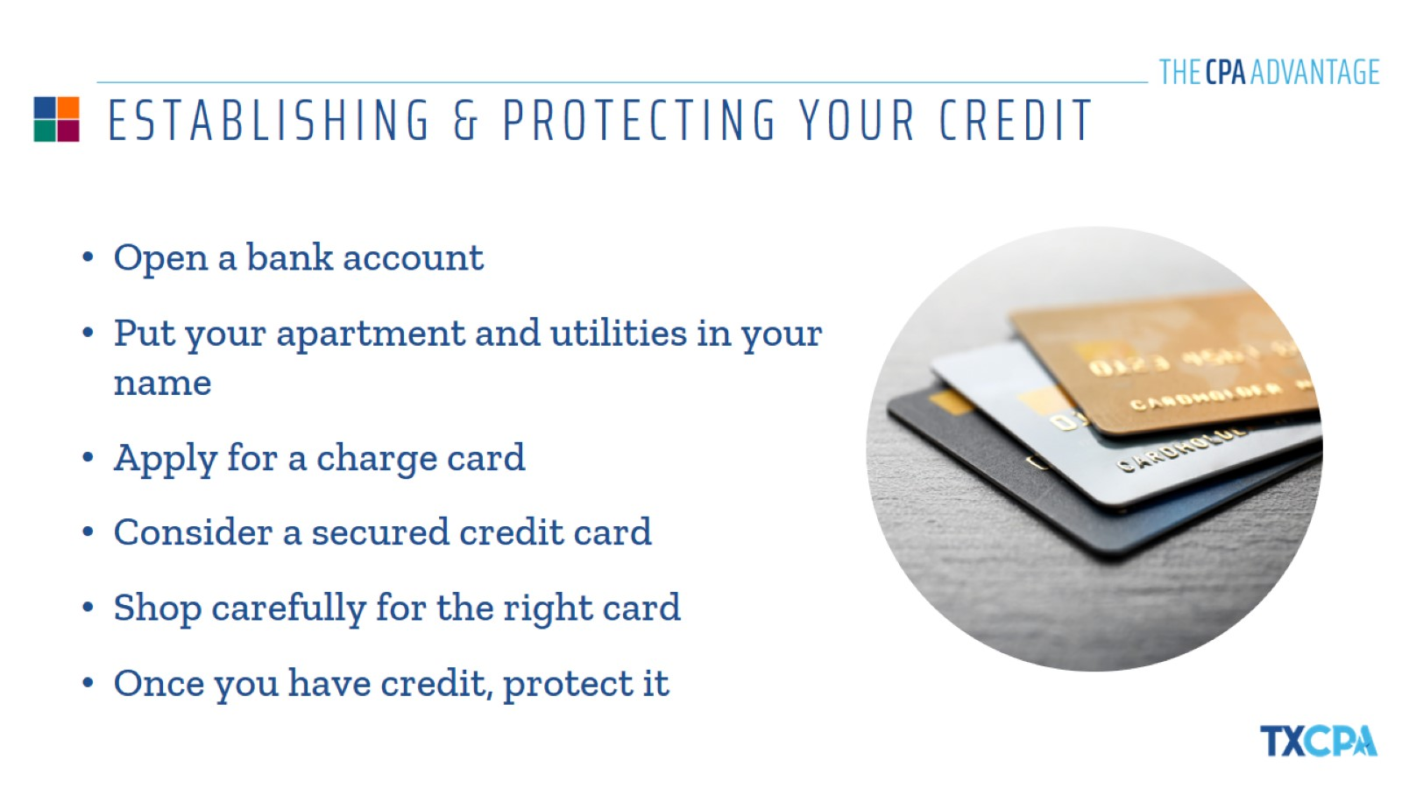
ESTABLISHING & PROTECTING YOUR CREDIT

Slide 15


Slide 16
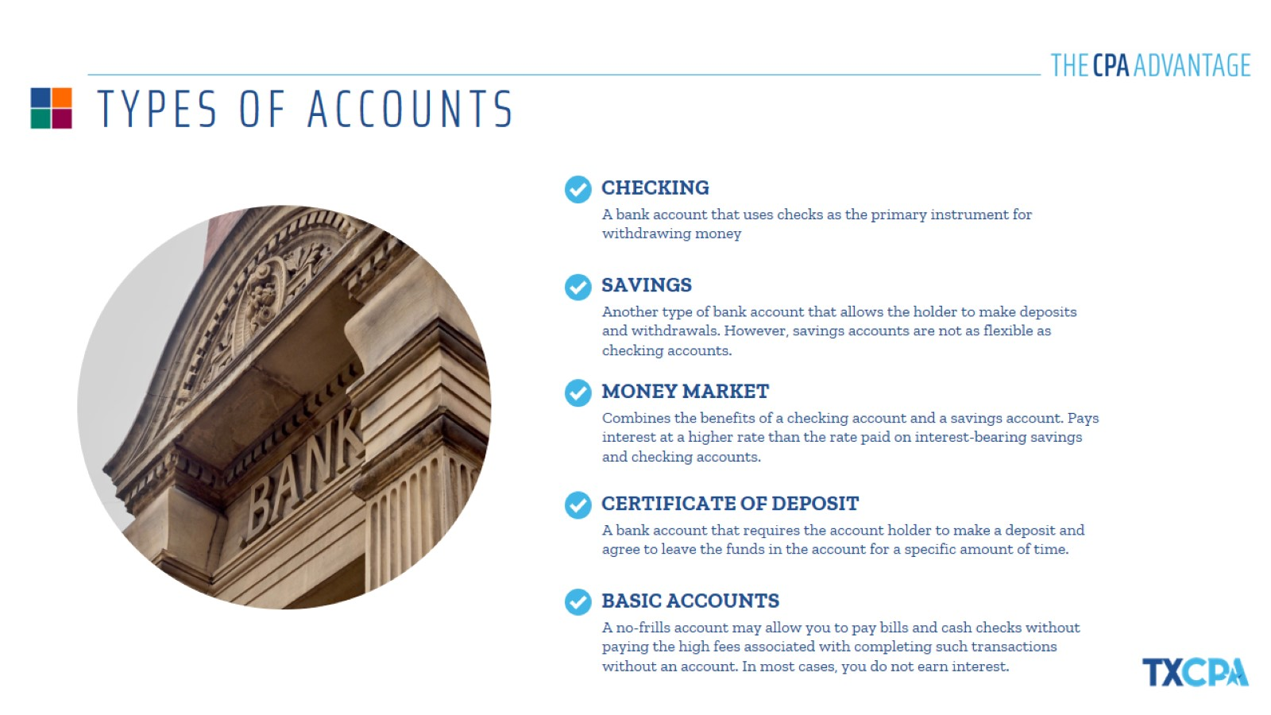
TYPES OF ACCOUNTS

Slide 17
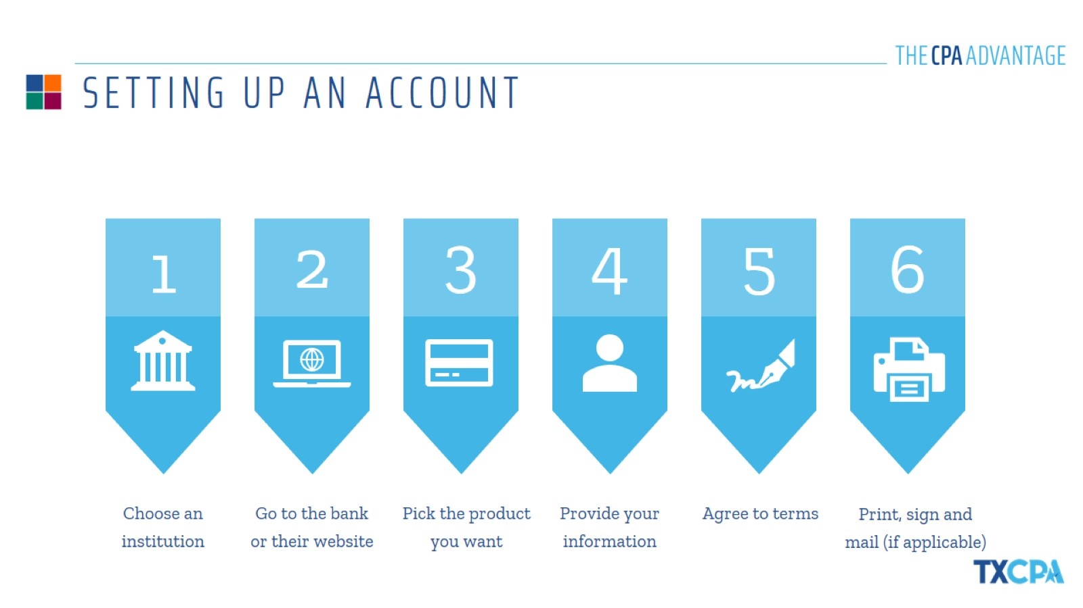
SETTING UP AN ACCOUNT

Slide 18
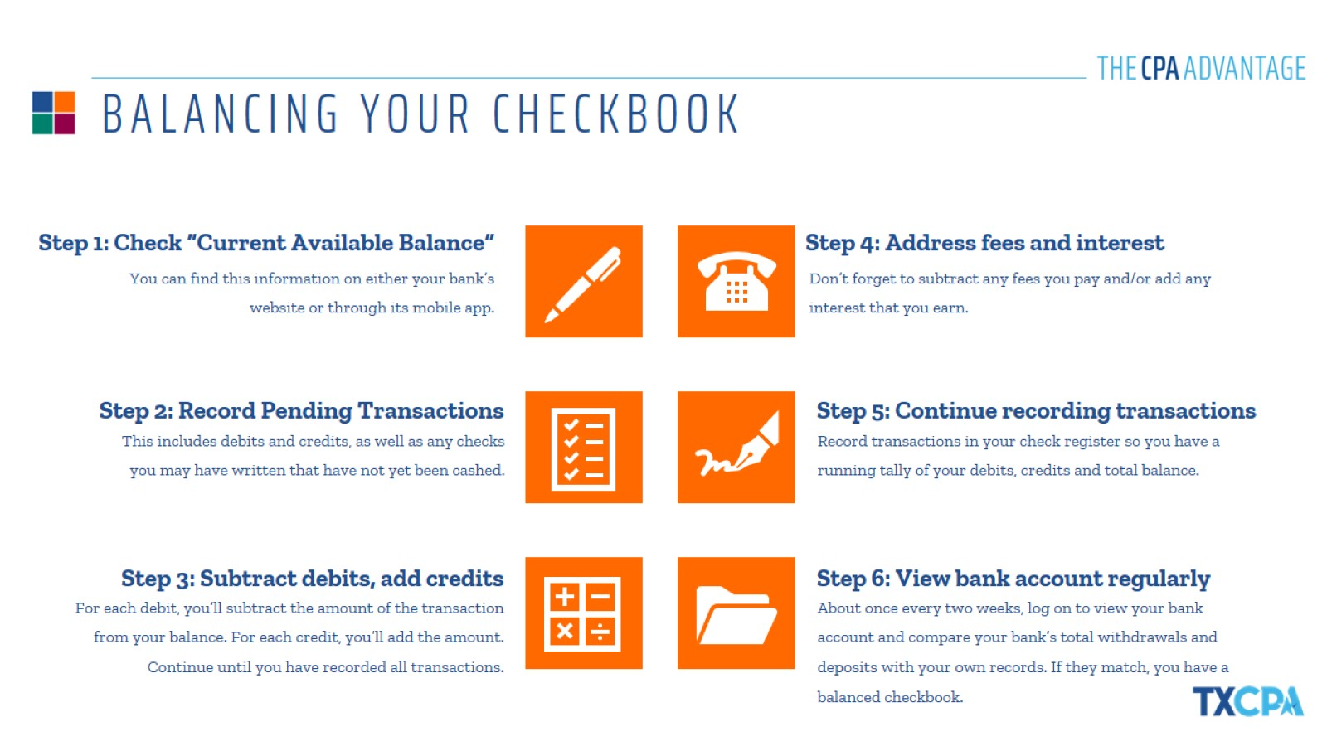
BALANCING YOUR CHECKBOOK

Slide 19
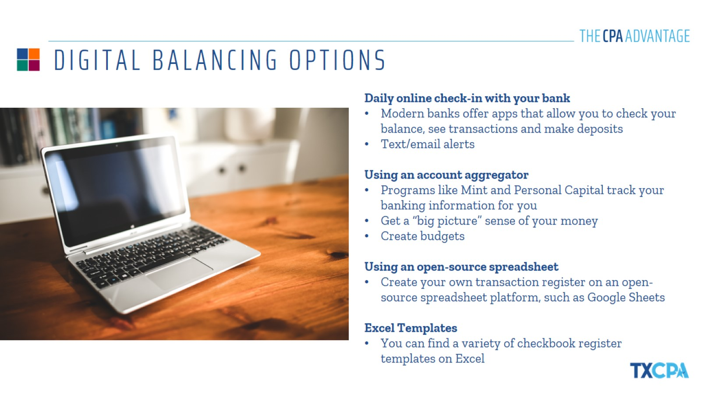
DIGITAL BALANCING OPTIONS

Slide 20


Slide 21

BUYING VS. LEASING A CAR

Slide 22
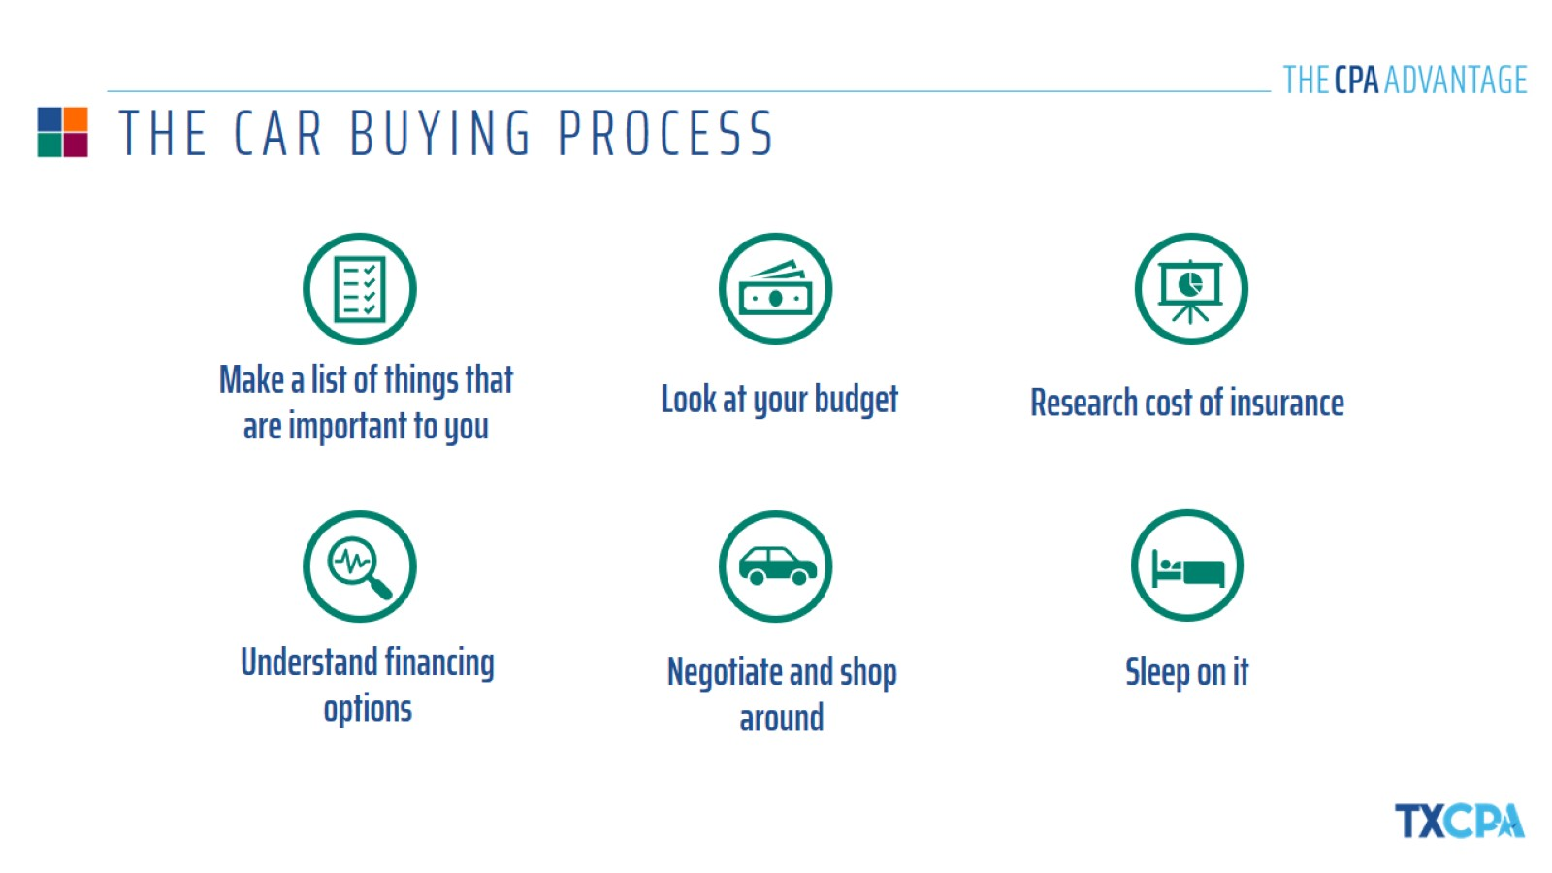
THE CAR BUYING PROCESS

Slide 23

ALL ABOUT AUTO INSURANCE

Slide 24


Slide 25

RENTING VS. OWNING A HOME

Slide 26
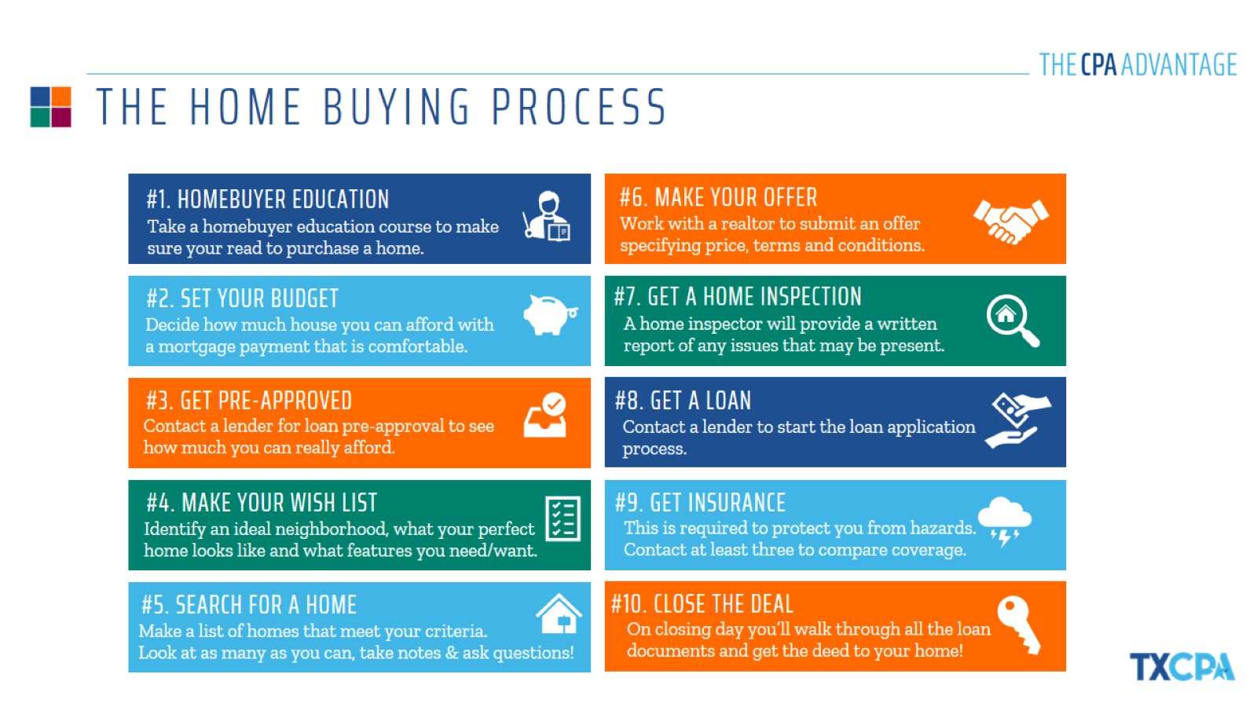
THE HOME BUYING PROCESS

Slide 27
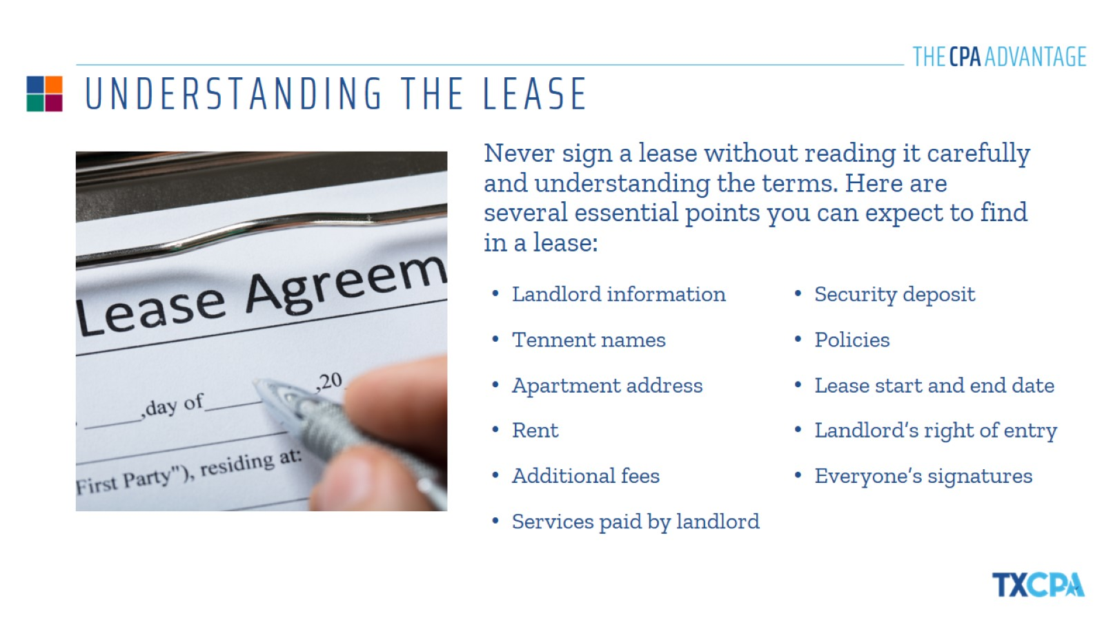
UNDERSTANDING THE LEASE

Slide 28
THANK YOU!
{NAME}
{COMPANY}
{DATE}

