Slide 1
MONEY MANAGEMENT 101:
A GUIDE TO FINANCIAL BASICS FOR STUDENTS
{NAME}
{COMPANY}
{DATE}

Slide 3
YOUR PAYCHECK AND SAVINGS

Slide 4
BE A SAVVY SHOPPER

Slide 6
UNDERSTANDING TAXES

Slide 7
UNDERSTANDING TAXES

Slide 9
WHAT IS BUDGETING?

Slide 10
CREATING A BUDGET

Slide 11
KEEPING YOUR BUDGET ON TRACK

Slide 13
CREDIT CARD ADVICE

Slide 14
ESTABLISHING & PROTECTING YOUR CREDIT

Slide 16
TYPES OF ACCOUNTS

Slide 17
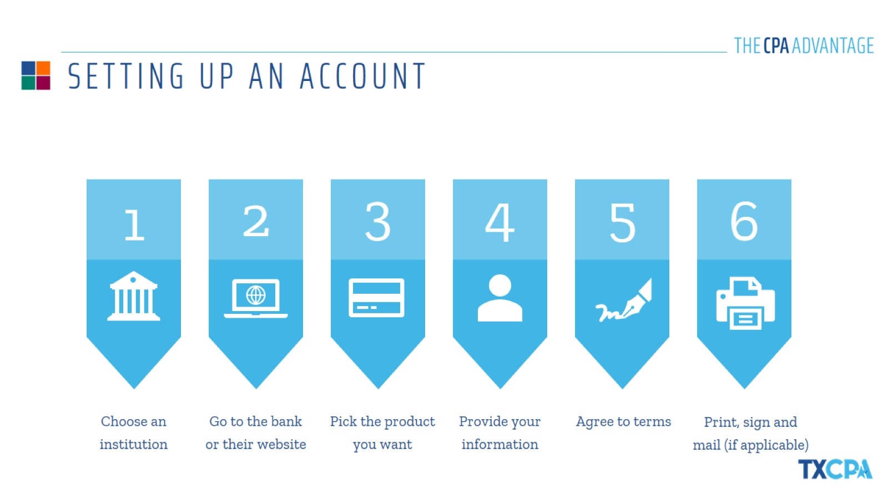
SETTING UP AN ACCOUNT

Slide 18
BALANCING YOUR CHECKBOOK

Slide 20
UNDERSTANDING STUDENT LOANS

Slide 21
STRATEGIES TO PAY OFF STUDENT LOANS

Slide 23
THE PROCESS

Slide 24
ALL ABOUT AUTO INSURANCE

Slide 26
UNDERSTANDING THE LEASE

Slide 27
IMPORTANCE OF RENTER’S INSURANCE

Slide 28
THANK YOU!
{NAME}
{COMPANY}
{DATE}

